Slide 1
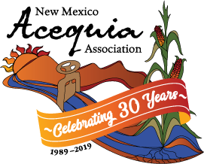
Acequia Disaster Recovery
Presentation to the Wildland Urban Fire Summit
October 10, 2024

Slide 2
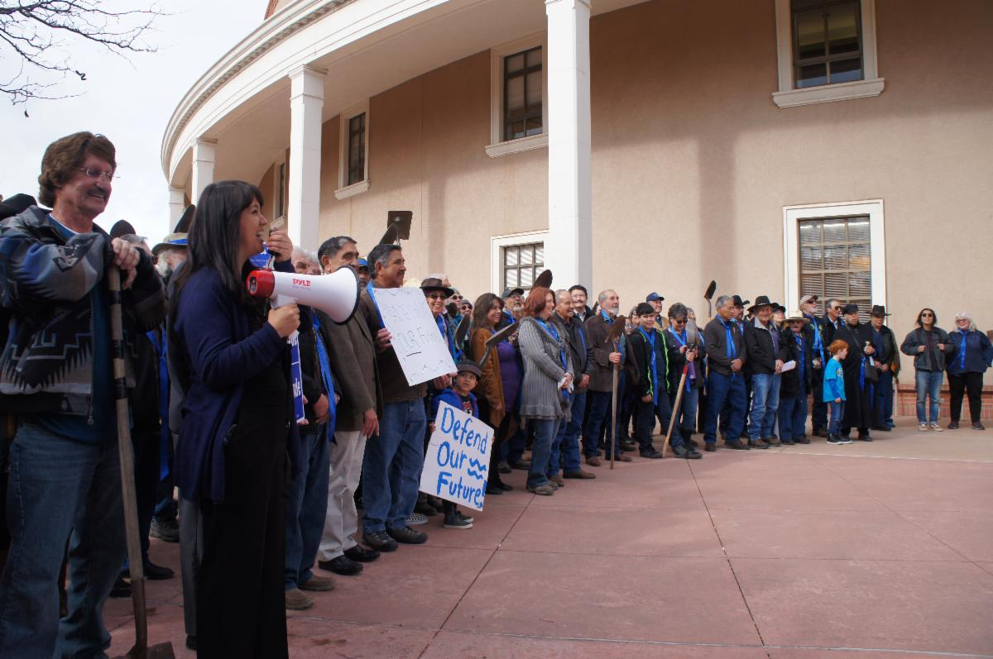
The New Mexico Acequia Association is a grassroots, membership based organization of acequias and community ditches in New Mexico. Since 1989, we have been working to protect acequias and agricultural water rights through community education, organizing, and advocacy.
Our vision is for acequias to flow with clean water where we work together to grow food and celebrate our cultural heritage.

Slide 3
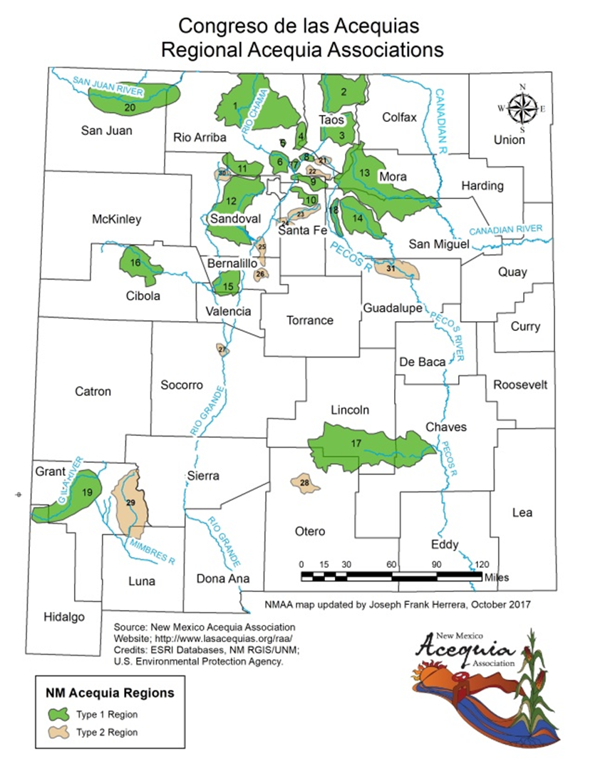
~700 Acequias in
New Mexico
Rio Grande and Tributaries
San Juan River
Rio Chama
Nambe/Pojoaque/Tesuque
Pecos River (Gallinas)
Pecos River
Canadian (Mora)
Rio Pueblo/Rio Embudo
Jemez River
Rio San Jose
Hondo River
Gila River
Mimbres River

Slide 4
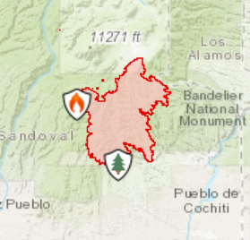
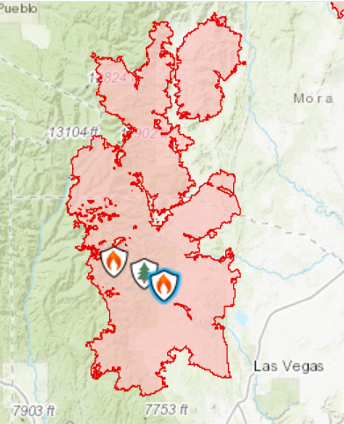
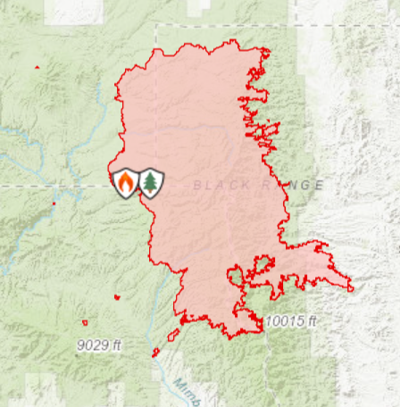
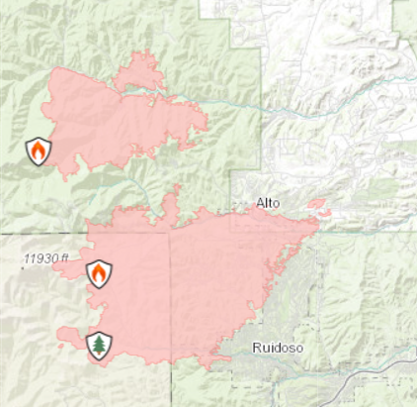
Catastrophic Wildfires since 2022
Cerro Pelado Fire
45,605 Acres
1 damaged Acequia (numerous)
Hermits Peak Calf Canyon Fire
341,735 Acres
90+ Damaged Acequias
Black Fire
325,136 Acres
24 Damaged Acequias
Blue Fire and South Fork/Salt
7532 + 17569 acres
30+ acequias

Slide 5
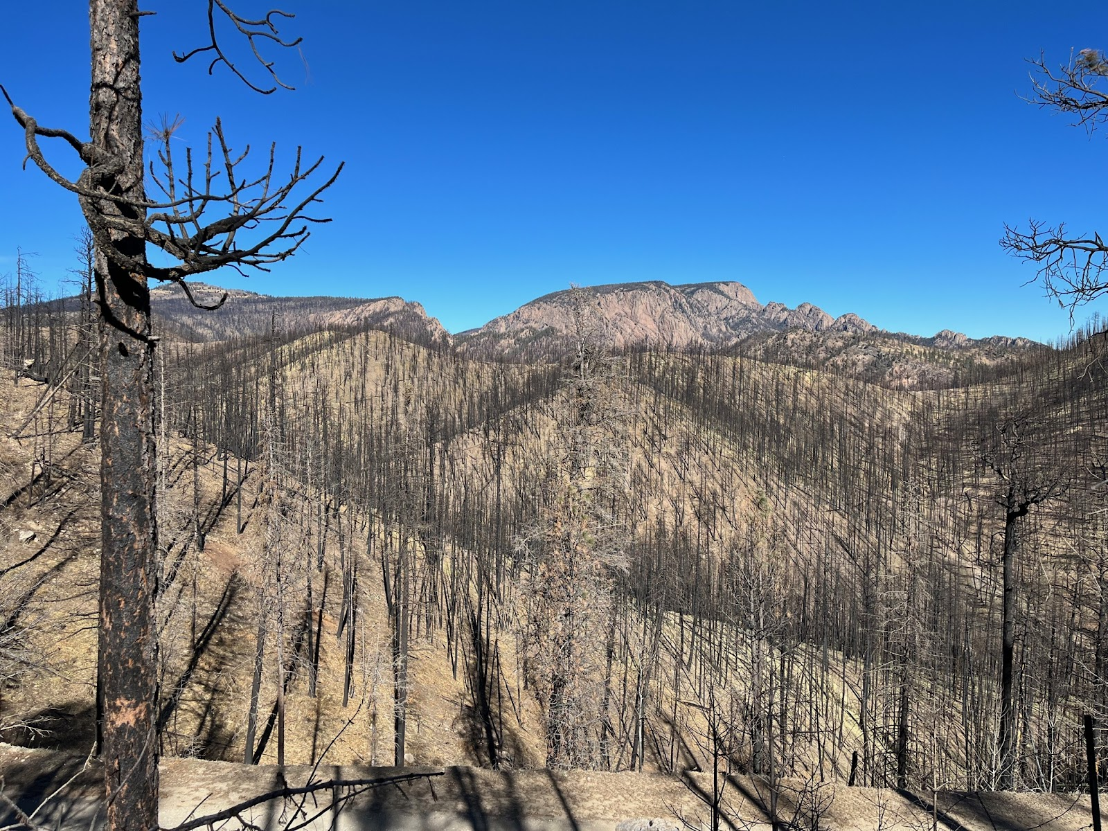

Slide 6
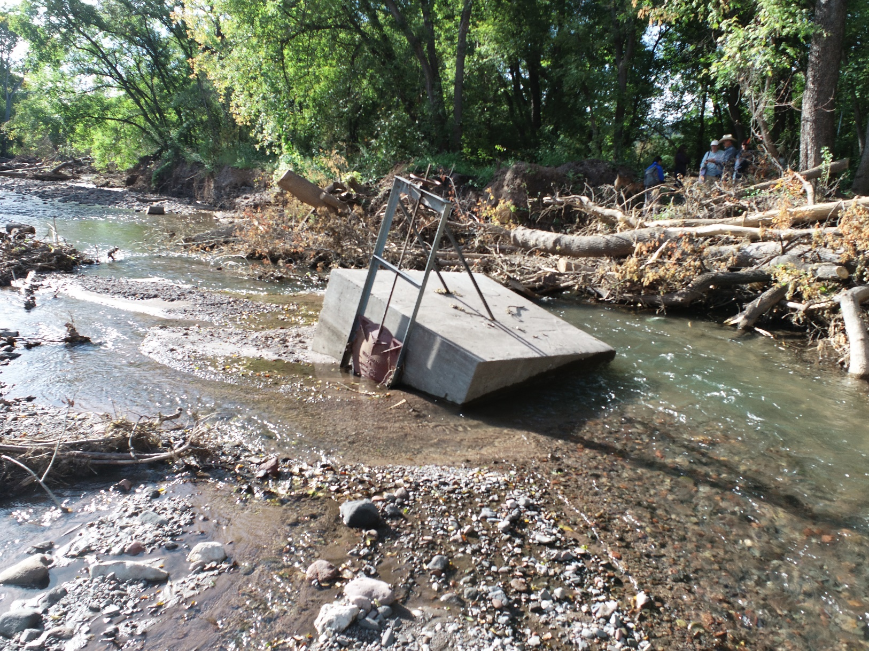
Impacts on Acequias from Post-Fire Flooding
Realignment of and damage to river channel causing diversion structures could be disconnected from the river.
Debris flows may damaged structures, such as diversions, headgates, dividers, sluces, crossings, etc.
Heavy flooding may damage structures by dislodging them or washing them away, by damaging fences, and by causing erosion.
Debris flows, ash, and sediment can clog acequia waterways and can deposit on farmlands.
Above: Flooding from the Black Fire and impacts to the Grijalva Ditch Diversion in Grant County

Slide 7
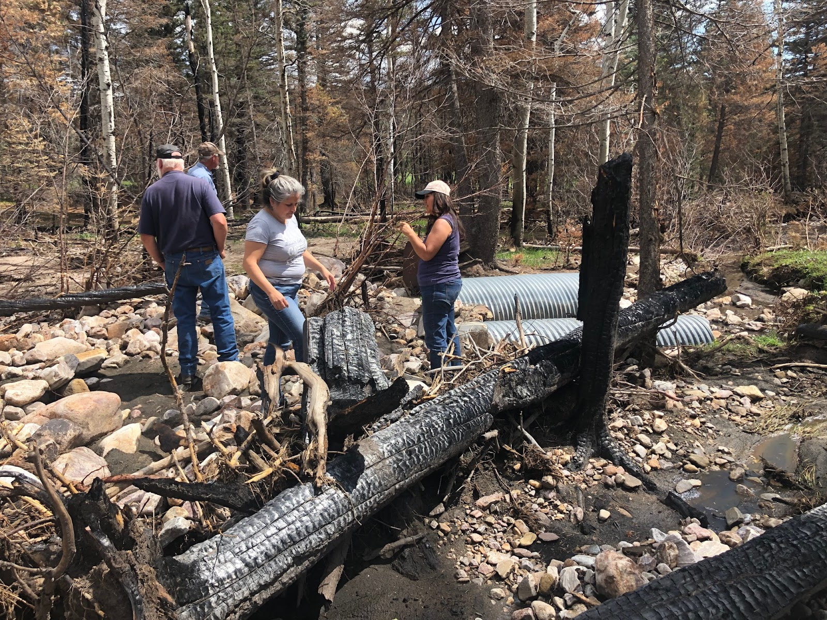
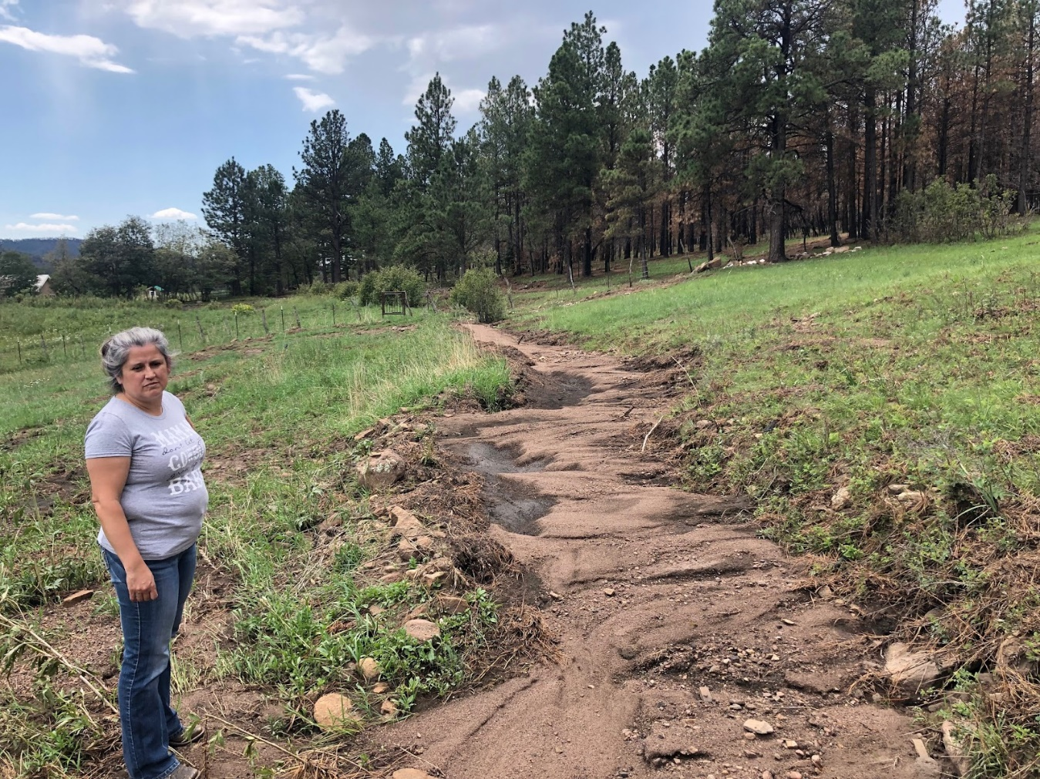
Burn Scar Flooding, Acequia del Lado Sombrillo
Flooding from the HPCC burn scar in Gascon, Mora County destroyed the diversion structure and changed the flow of the river. The acequia waterway was clogged with silt and debris from burned forest on the side slopes.

Slide 8
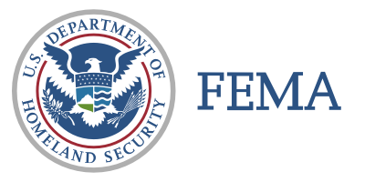
The following two agencies are involved in providing disaster assistance to local governments:
♦ Department of Homeland Security and Emergency Management (DHSEM). This is the state agency that responds to disasters in New Mexico. When the Governor declares a disaster, then DHSEM can use state funds to assist local governments with disaster response and recovery.
♦ Federal Emergency Management Administration (FEMA). This is the federal agency that responds to federal disasters. A disaster in New Mexico can be declared a federal disaster by the President if it exceeds a certain size and cost. This makes available federal dollars at a much higher amount than is available for a state disaster.

Slide 9
Quick facts about DHSEM and FEMA assistance:
In a federal disaster, your Acequia will submit the RPA through NMAA to DHSEM and then DHSEM will enter your RPA into the FEMA grants portal. Other documentation will be required including:
Bylaws
GPS Coordinates of Point of Diversion
Possibly other letters from the Acequia
For a state disaster, the cost share is 75% state and 25% local.
For a federal disaster, the cost share is 75% federal (FEMA), 12.5% state (DHSEM), and 12.5% local. (HPCC is 100% federal)
These programs are reimbursement grants. The local entity does the work up front and can get reimbursed by DHSEM (FEMA sends funds to local entity through DHSEM to be administered to the Acequias).
There are several categories of assistance:
Debris Removal
Emergency Measures
Roads and Bridges
Water Control
Buildings and Equipment
Utilities
Parks and Recreation
Z. Project Management
The most relevant categories for assistance for Acequias will be:
Debris Removal
C. Culverts (Roads and Bridges)
D. Water Control
Z. Project Management

Slide 10
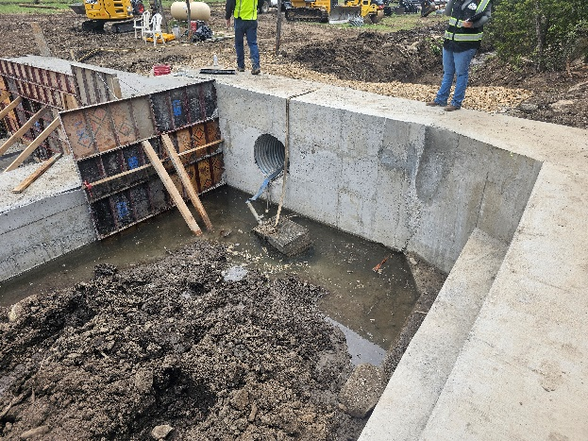
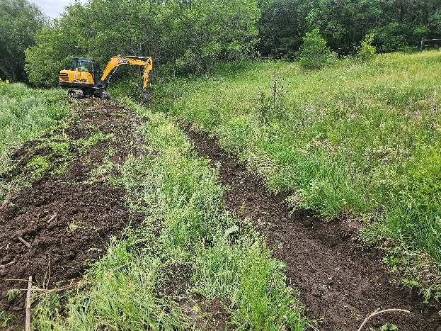
The NRCS EWP Program offers technical and financial assistance to help local communities relieve imminent threats to life and property caused by floods, fires, windstorms and other natural disasters that impair a watershed. Some of the purposes of EWP:
Remove debris from stream channels, road culverts and bridges;
reshape and protect eroded streambanks;
correct damaged or destroyed drainage facilities;
establish vegetative cover on critically eroding lands;
repair levees and structures
EWP does not require a disaster declaration by federal or state government officials for program assistance to begin. The NRCS State Conservationist can declare a local watershed emergency and initiate EWP program assistance in cooperation with an eligible sponsor, usually a local Soil and Water Conservation District.
How to get assistance:
To request an emergency declaration, a community should contact their local SWCD who can contact the State Conservationist to declare an emergency.
The local sponsor administers the application process. It is generally a simple application. Then the sponsor does a damage assessment and determines a scope of work for repairs.

Slide 11
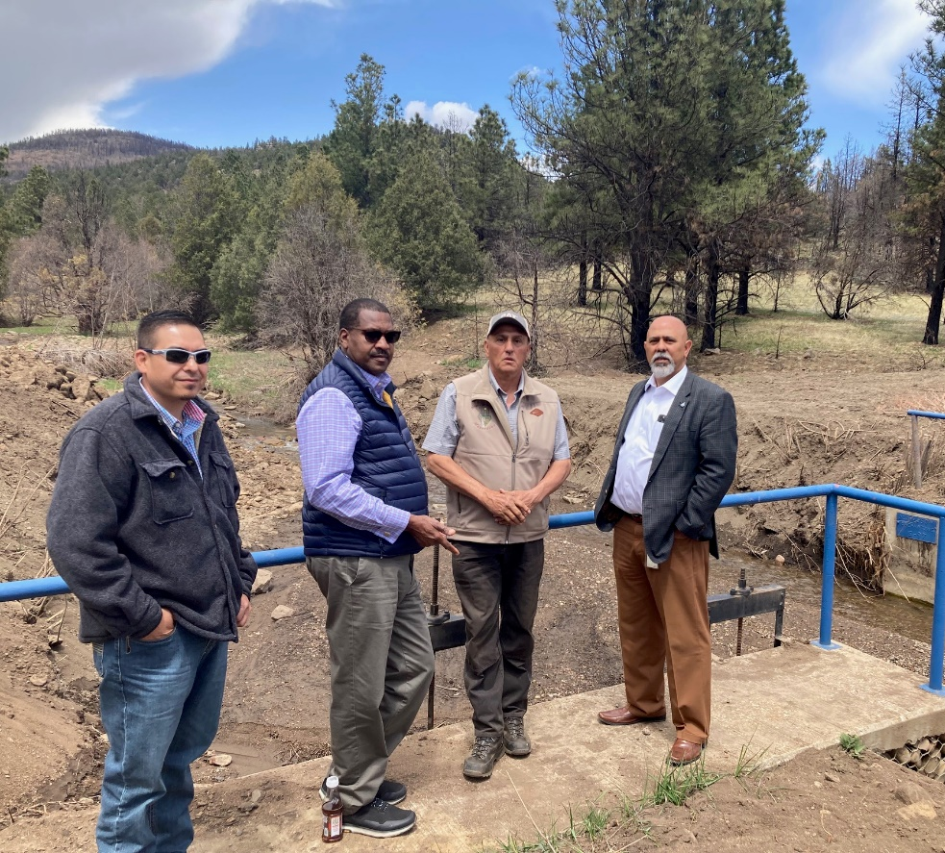
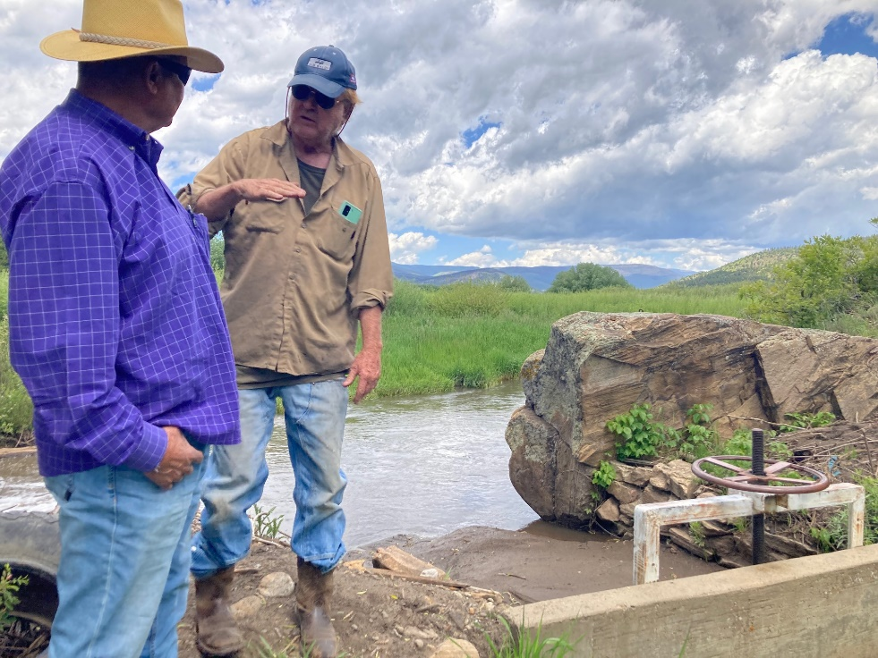
USDA NRCS
Emergency Watershed Program (EWP)
How it works:
Local sponsor is required, usually a SWCD or a County
25% local cost share match is required (except for HPCC where 100% is covered)
In the HPCC and Black Fires, the EWP program has been used for structural repairs on Acequias.
EWP has a 75/25 federal/local cost share. This was waived in the HPCC disaster but other disasters have required the 25% match. In the Black Fire, state funding was used for the 25% local match from a special appropriation from the State Legislature.
EWP and Acequias:
NRCS and the sponsor cover all the costs of design and construction. The sponsor takes care of procurement.
State and local government need more capacity to serve as sponsors. There is no reliable source of cost share.
State funds needed to leverage EWP!

Slide 12
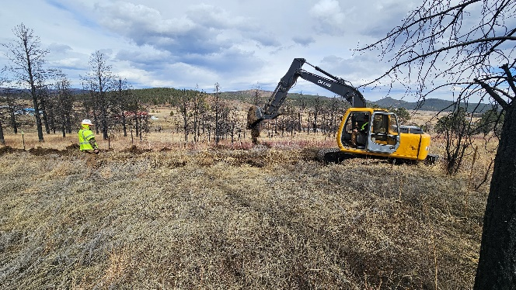
NMDOT (Department of Transportation) Debris Removal. After 2022 disasters, the State of New Mexico, with leadership from Governor Michelle Lujan Grisham and DOT Secretary Ricky Serna, established a program that authorizes NMDOT to conduct debris removal on Acequias.
For example, after flash flooding in Rio Arriba County (Dixon) in 2022, NMDOT mobilized contractors to remove silt from Acequias. This was a state disaster and the funds were covered through DHSEM via a Governor’s Executive Order.
For the Black Fire, NMDOT also mobilized local contractors to do debris removal on Acequias impacted by burn scar flooding. State funding was used for this work
For the HPCC Fire, NMDOT mobilized local contractors for debris removal. The cost was covered by the state and then reimbursed by the FEMA Public Assistance Program. This required extensive coordination between DHSEM, FEMA, NMDOT and their contractors, and NMAA.
This program is mobilized on a case-by-case and as-needed basis. The structure and process may vary depending on the disaster.
This program is currently NOT IN PLACE for Rio Chama or Ruidoso flooding.

Slide 13
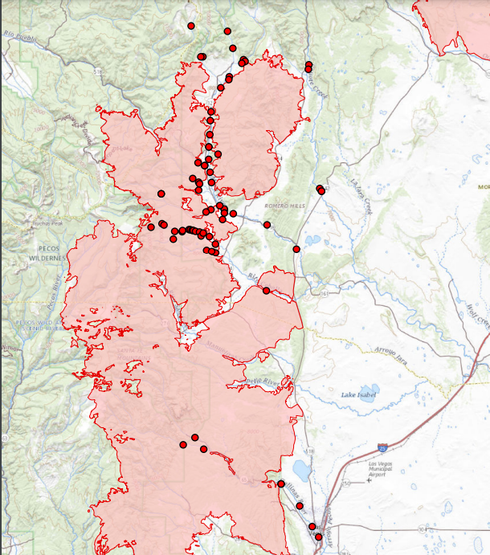
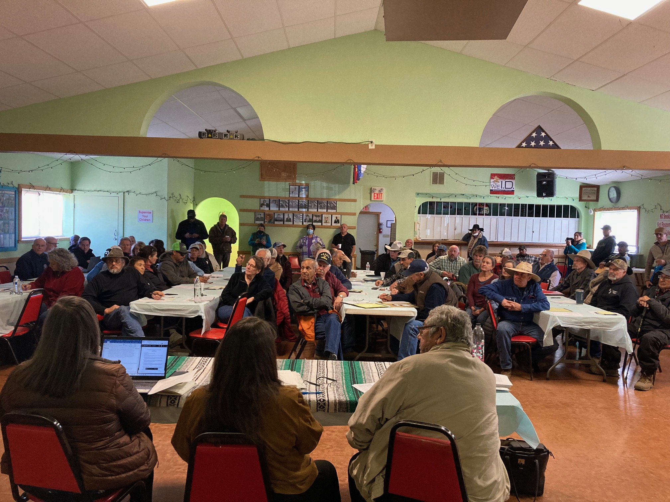
Hermits Peak/Calf Canyon
Acequias mapped and inventoried 90+
FEMA RPA Applications 70+
NMDOT Debris Removal MOA 40+
NMDOT Completed 40+
NRCS EWP Applications 70+

Slide 14
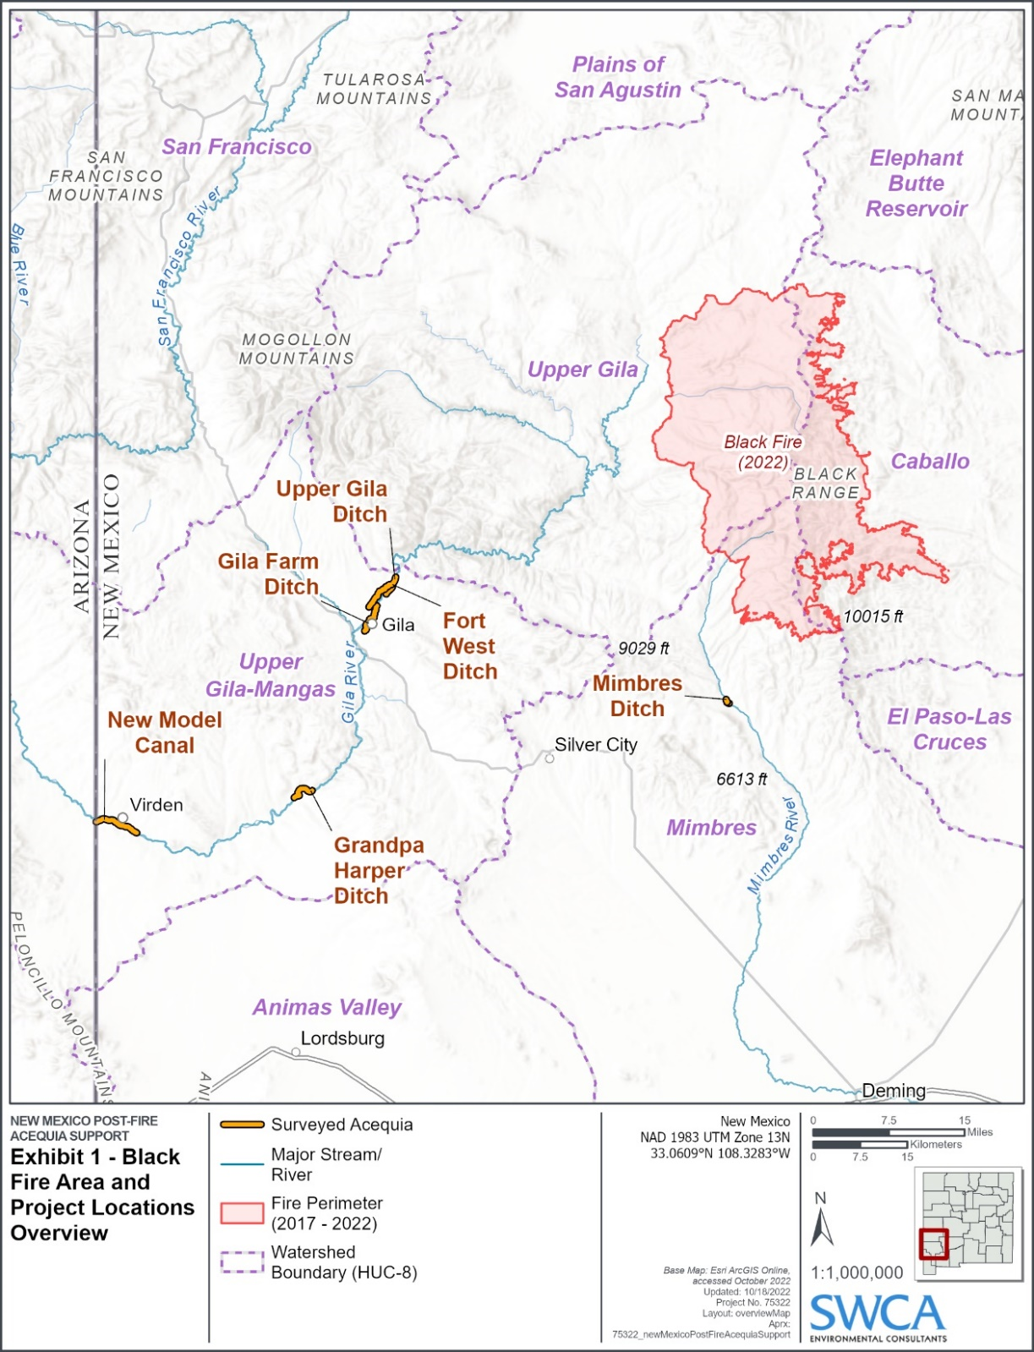
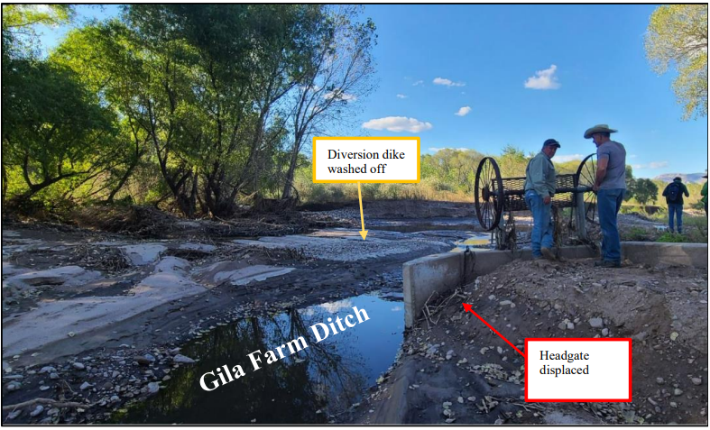
Black Fire
Acequias Mapped and Inventoried 20
NMDOT Debris Removal 10
ISC Damage Assessments 10
DHSEM DAP Applications 15
EWP 10+?

Slide 15
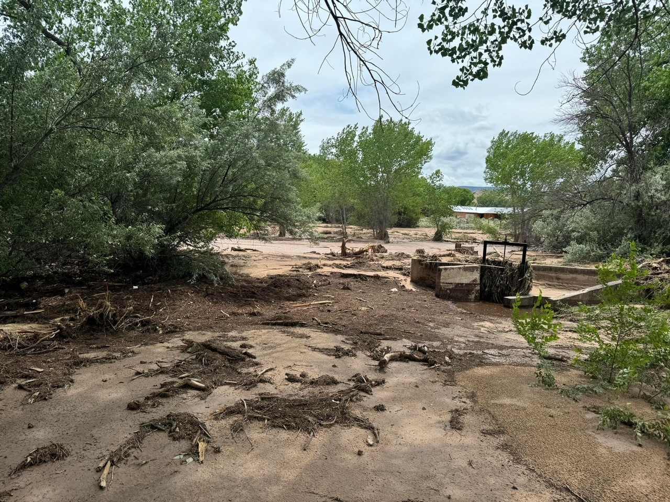
2024 Floods
Rio Chama: Flooding came from the side arroyos running from the old Cerro Grande burn scar and high rainfall.
Ruidoso: Burn scar flooding from the Salt – South Fork Fire.
NMAA is working with:
22 acequias in the Upper Hondo (Ruidoso)
8 acequias on the Rio Chama
Partners: FEMA, DHSEM, NRCS, local SWCD and RC&D

Slide 16
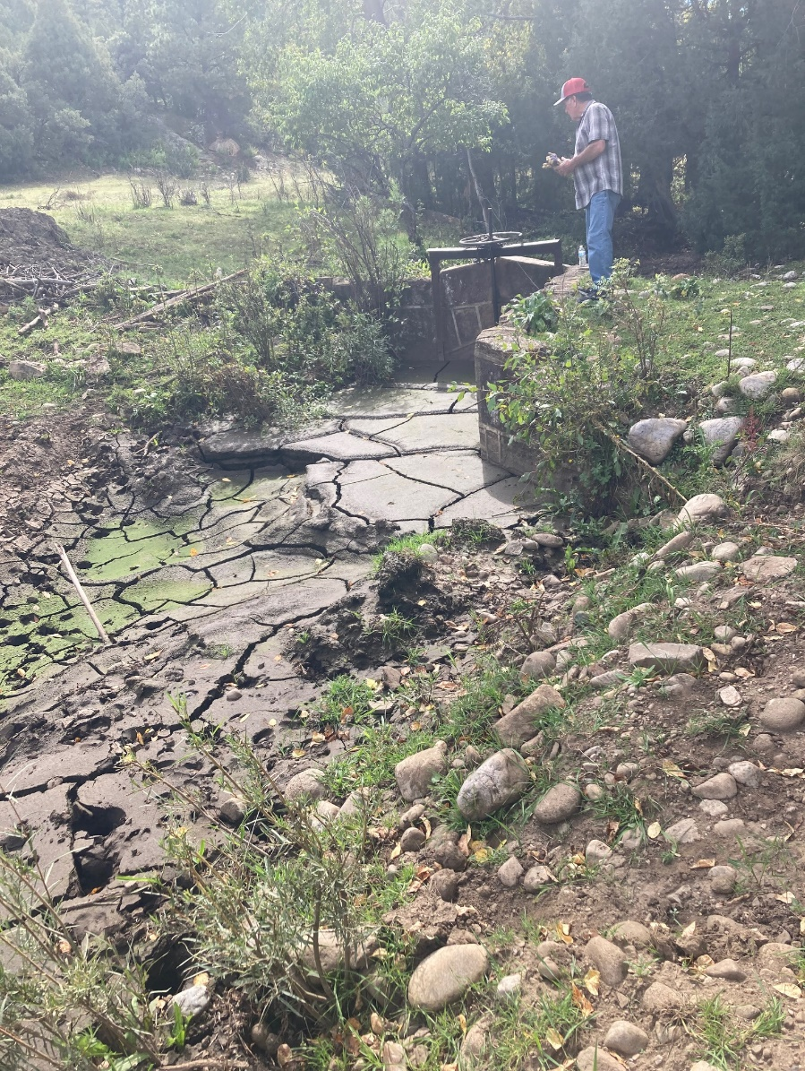
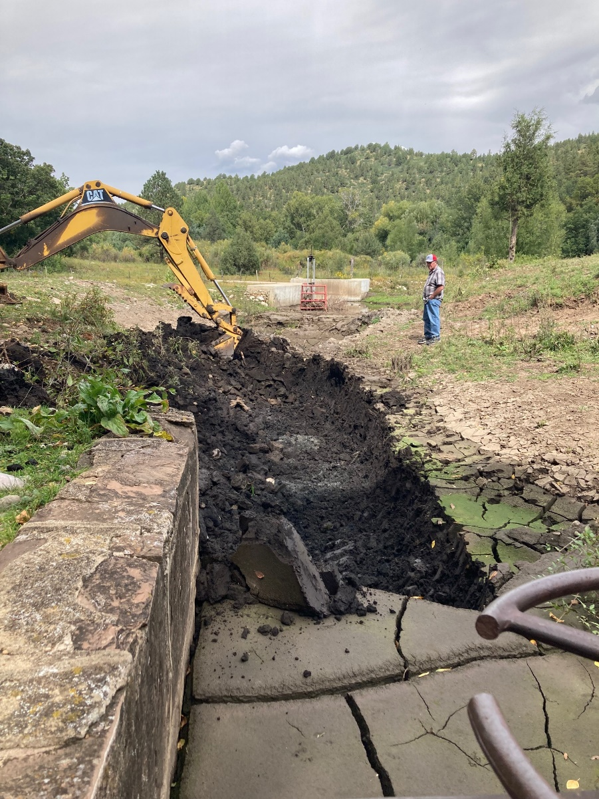

Slide 17
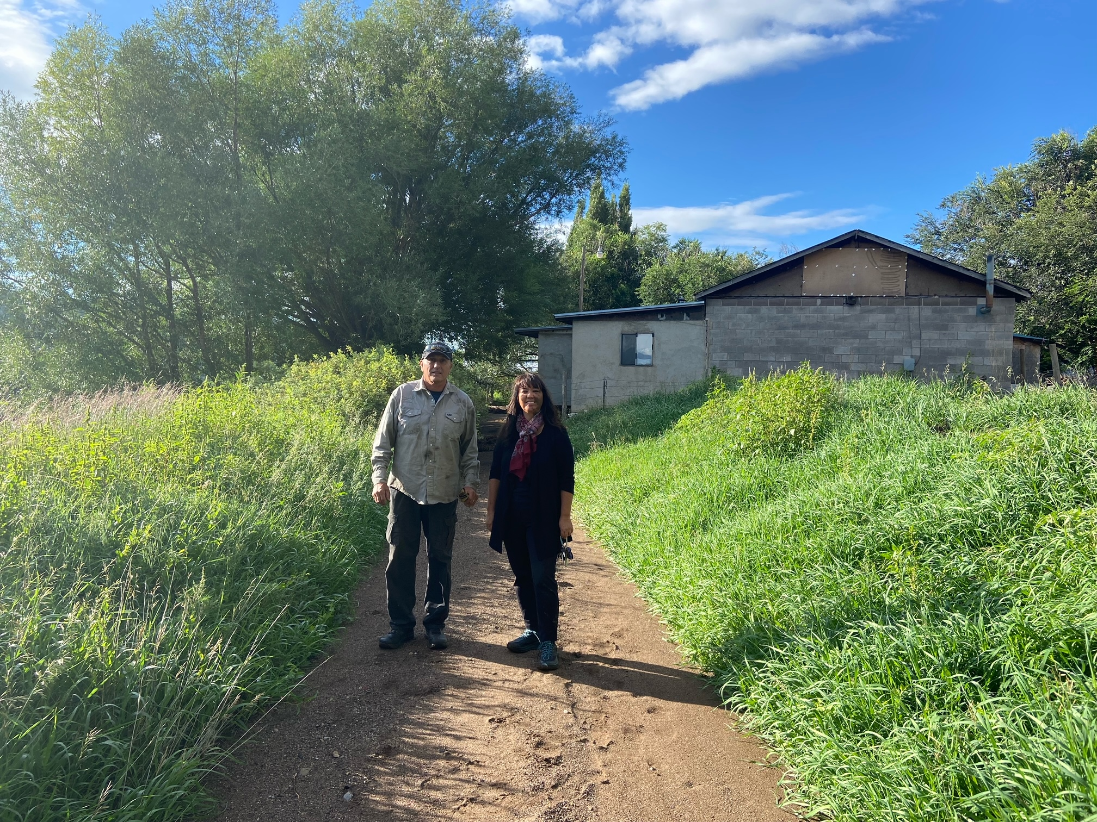
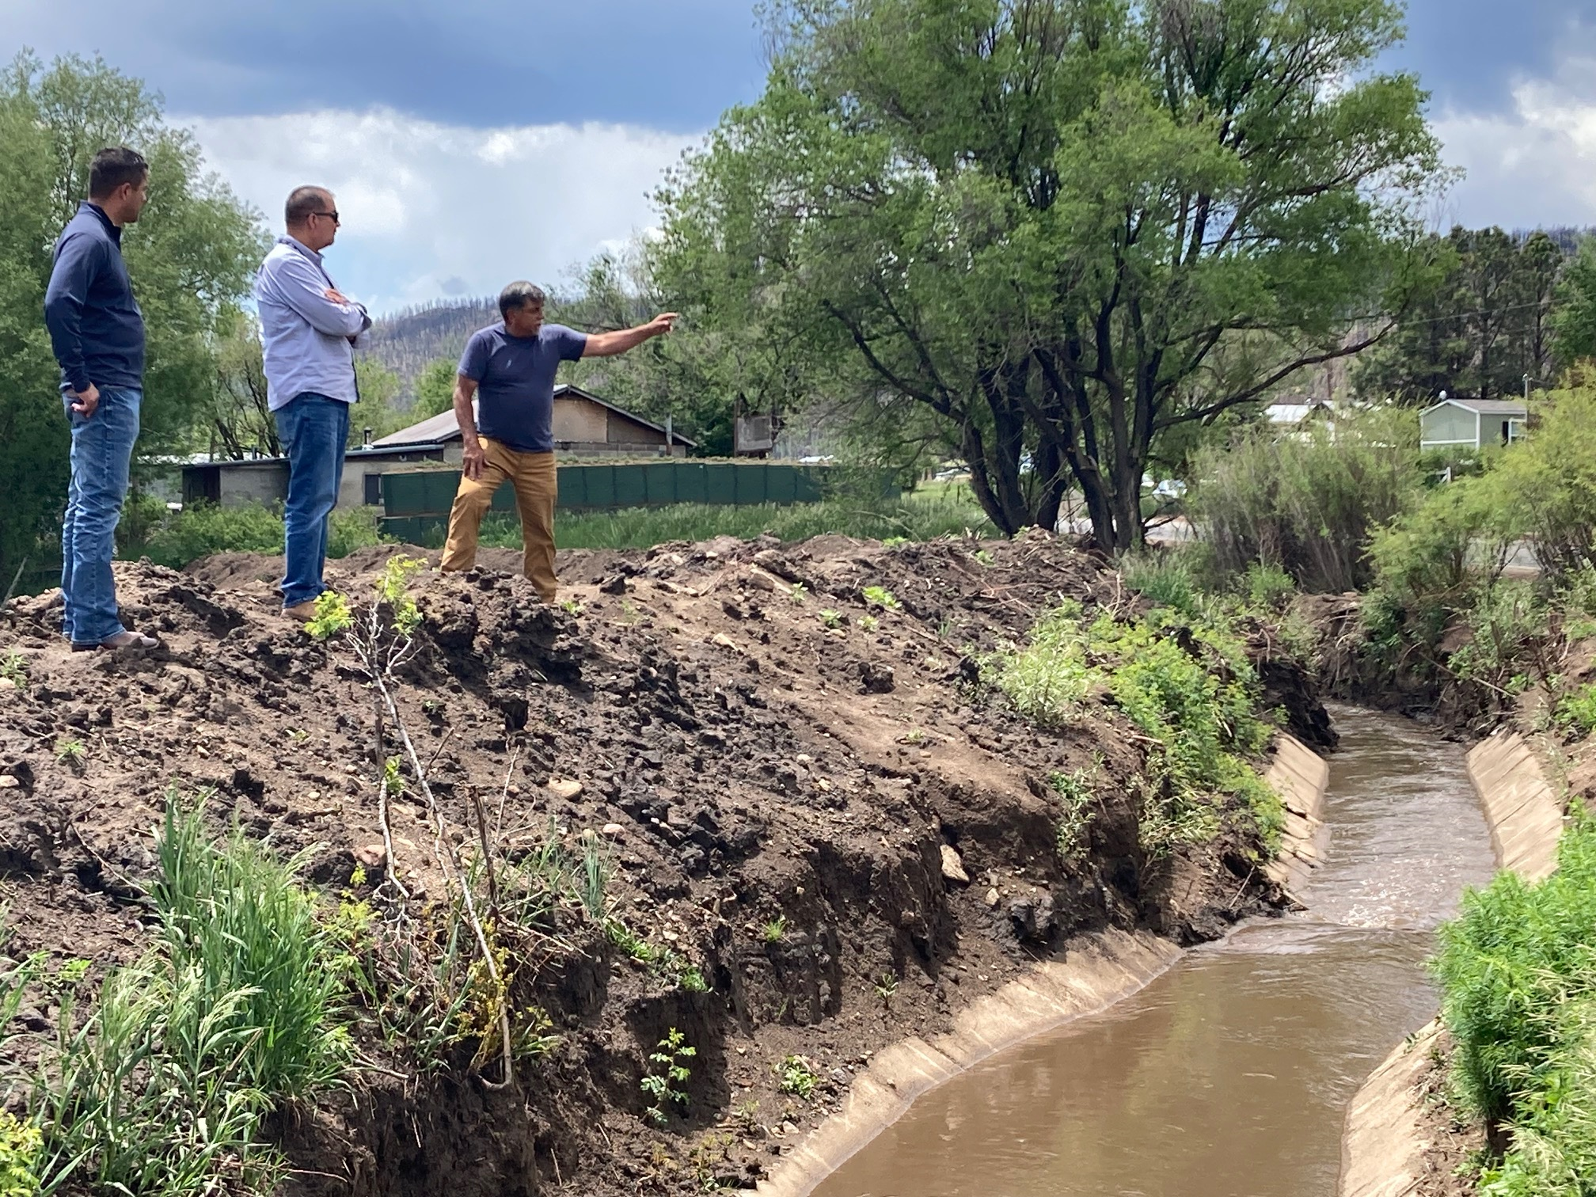
Debris Removal by NMDOT
Acequia Madre de Holman
BEFORE
AFTER

Slide 18
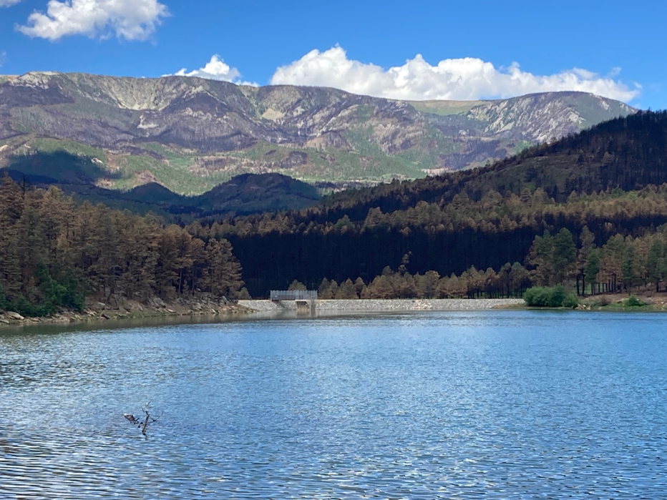
Watersheds
USDA programs leave gaps: FSA ECP, and FSA EFRP.
HPCC Claims is based on individual property and is a compensation model.
Landscape scale restoration and reforestation will require a massive investment from the federal government.
Communities need recovery grants.
Some Progress:
DHSEM Line of Effort
USFS
NRCS Watershed Operations Program
Reforestation Center

Slide 19
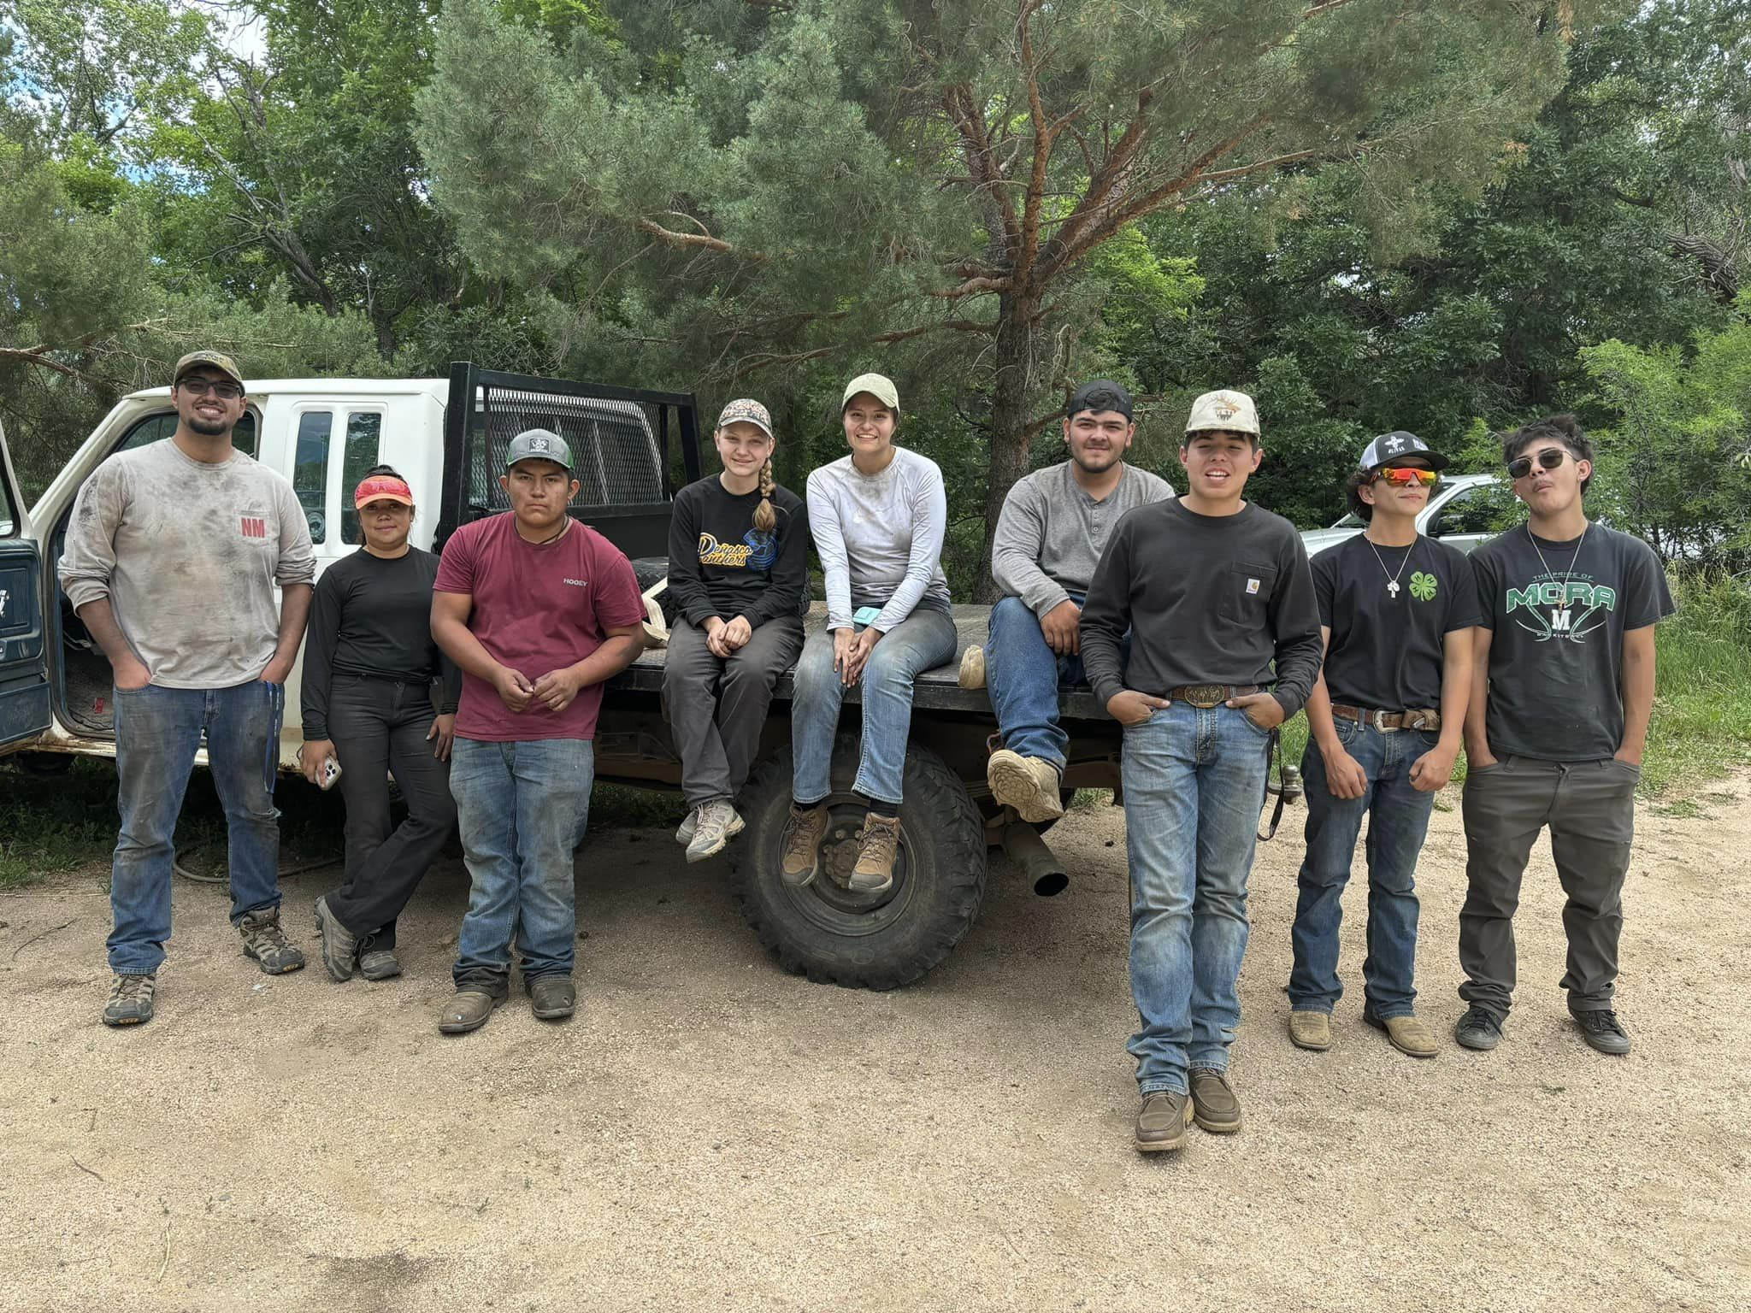
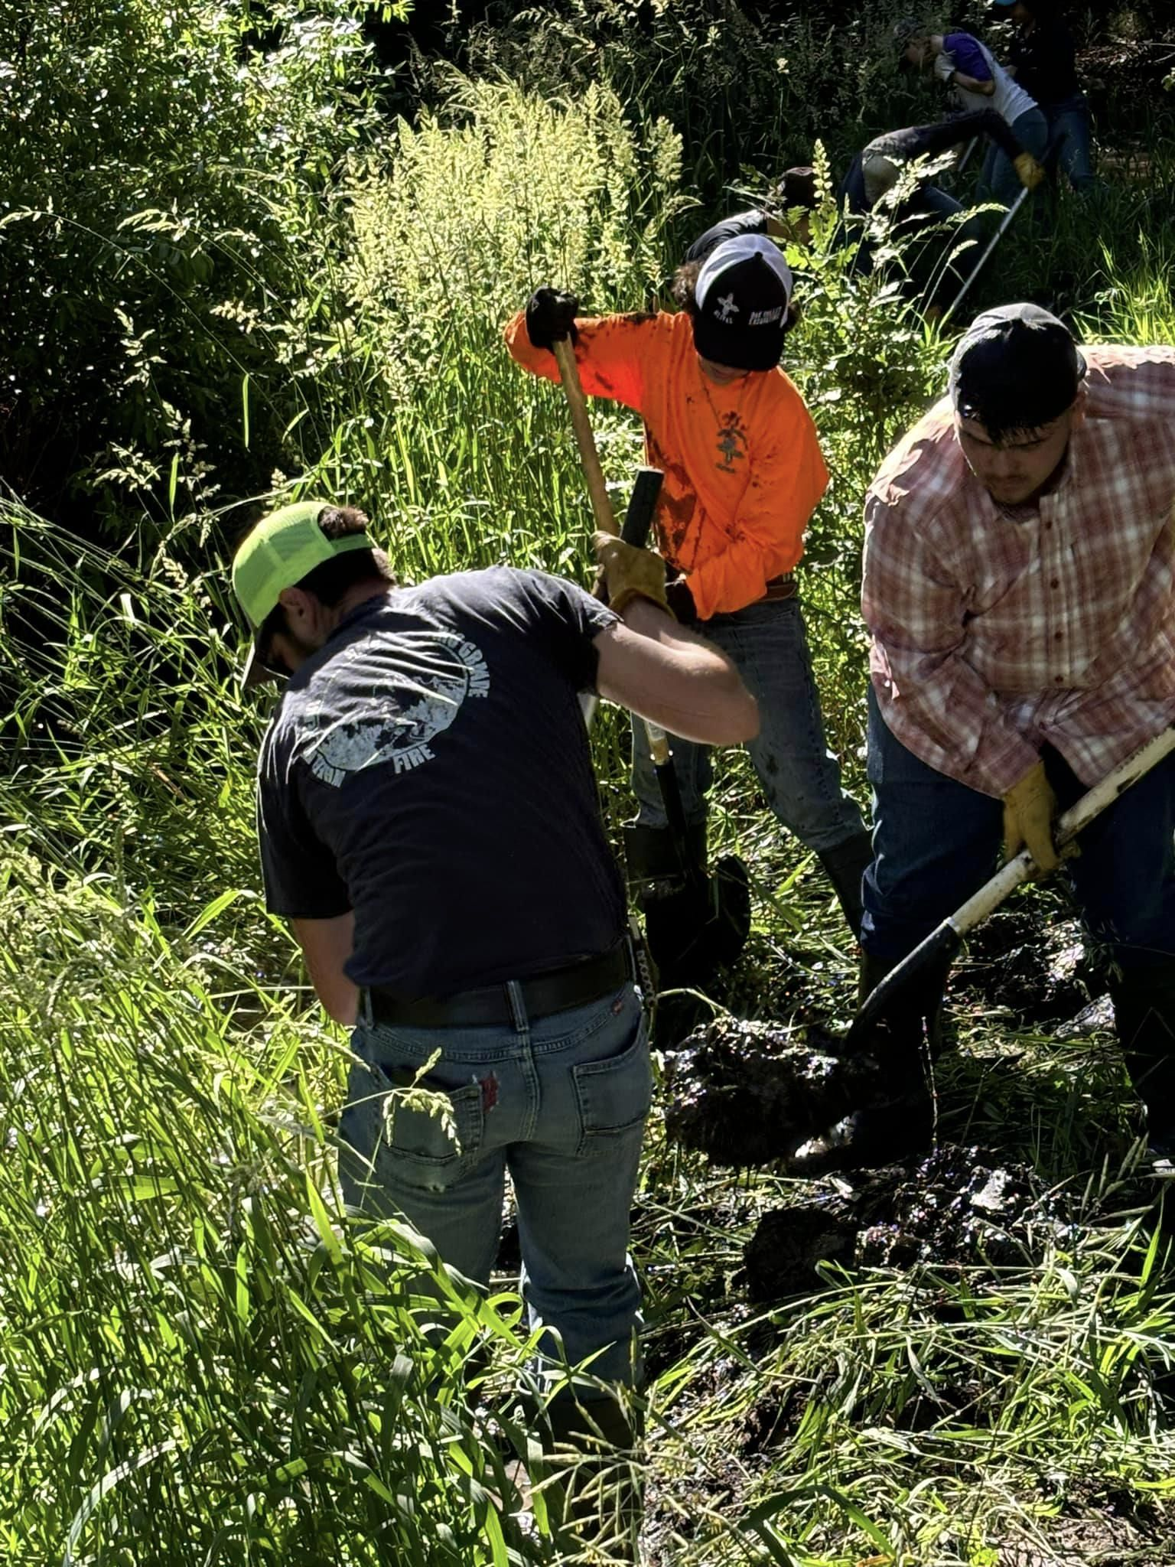
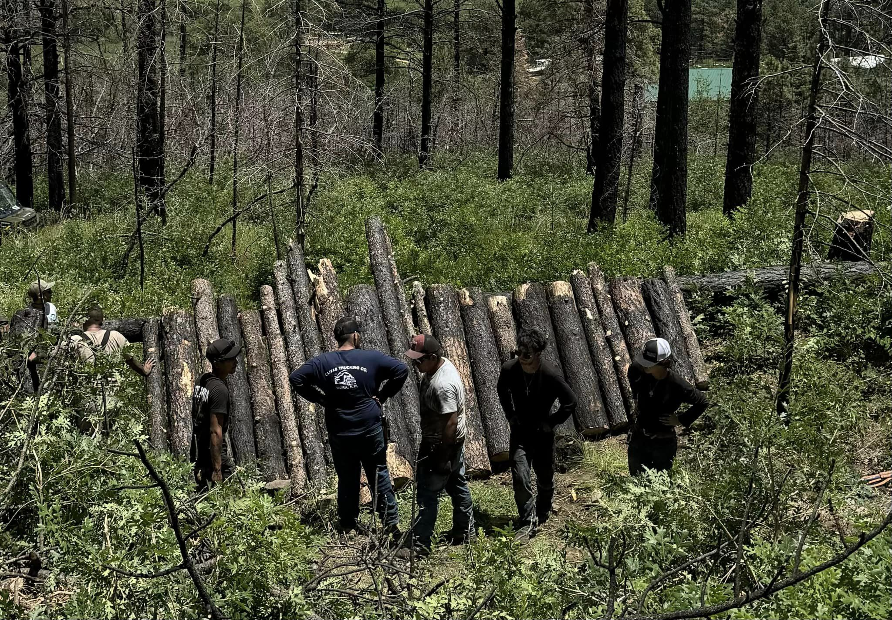
Mora Acequia Youth Conservation Corp
Acequia debris removal
Erosion control structures
Partnerships:
Hermit’s Peak Watershed Alliance
RiverSource

Slide 20
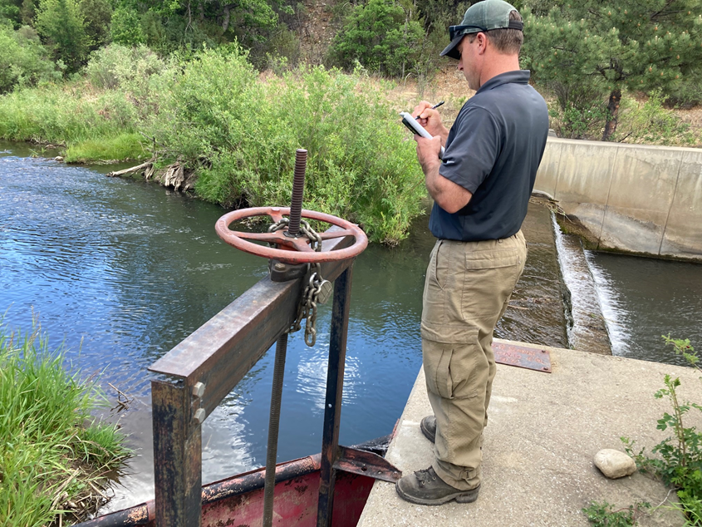
Recommendations
Meet cost share requirements for federal and state disaster programs with state funds. The ACDIF is structured to allow use of funds for cost share requirements. Special appropriations can be made as needed to the ISC for ACDIF so that the base budget for statewide projects is not diverted too much for disaster work.
Institutionalize the debris removal approach used by NMDOT to mobilize rapidly to remove flood debris. Options could be for NMDOT to continue, to set up similar process with DHSEM, or to engage local SWCDs to work with local contractors. An interagency group should form and develop a specific policy recommendation.
Increase support for technical assistance to acequias. Disasters are resource intensive and expertise is needed to develop maps, inventories, and contact lists as well as to navigate the disaster process. Trail local acequia leaders to be liaisons with disaster agencies.
High Water Mark has been vital to disaster response and recovery for acequias. Above: Matt Smith, Senior Program Manager.

