Slide 1
ArcGIS HUB as a Community Support Tool for Post-fire and Flood Events

Slide 2
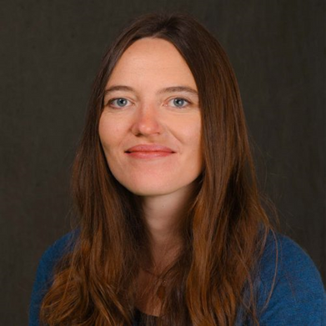
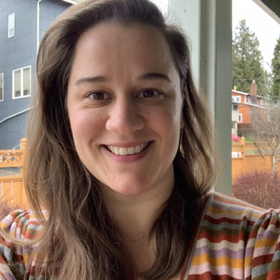
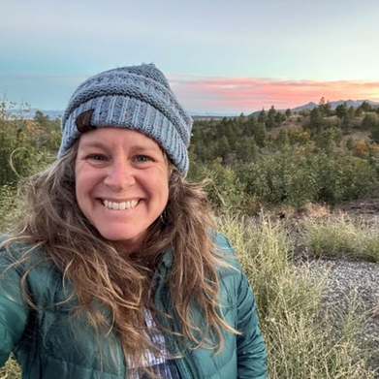
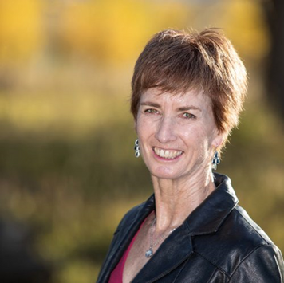
Meet our Team
Patti Dappen
GIS Program Manager & Administrator
Katie Withnall
GIS Specialist &
Data Manager
Dana Heusinkveld
GIS Research Specialist
Elizabeth Becker
GIS Senior Technician
Staci Matlock
Public Information Specialist
We work to reduce catastrophic wildfires and restore resilient, fire and climate adapted ecosystems. We collaborate with partners and engage communities to bridge scientific and local knowledge and build capacity in landscape-scale adaptive management.
nmfwri.org

Slide 3
Hermit’s Peak/Calf Canyon Fire
The HPCC fire was a record-breaking fire that lasted almost 6 months, burning over 340,000 acres of land and destroying 160 homes and more than 900 structures. Post-fire flooding caused further destruction and recovery efforts are still ongoing.

Slide 4
HPCC ArcGIS Hub Support Timeline
HPCC fires merge and spread
Fire response & containment
Fire recovery, post-fire flooding
Community rebuilding
Long term recovery
NM Fire Viewer
Cooperator’s Hub
Public Hub
Workshops &
Map Creator
HPCC Hub Site
Evacuation zones, fire perimeters, thermal hotspot detections, building footprints, land ownership, vegetation treatment information.
Public map consolidating available relevant data and embedded social media updates, information and resources.
Resource and contact information for long term recovery group, calendar of upcoming and recorded community events.
Collaborative mapping replaces static maps. Controlled access communication and data portal.
Community workshops covering post-fire restoration topics, resiliency fairs, and a public map creator tool.

Slide 5
New Mexico Fire Viewer
Developed in April 2022 soon after Hermit’s Peak fire started to meet immediate need.
Layers include satellite imagery, thermal hot spot detections, building footprints, land ownership, vegetation treatments, burn severity, and evacuation zones (during active fire).
Accessed over 300,000 times with an average viewership of 2,600 users per day during HPCC.
Has since been expanded statewide and is embedded in HPCC Hub site.
nmfireviewer.org

Slide 6
ArcGIS Online Hub
Esri’s community engagement and collaboration platform.
Widget-based website builder.
Uses ArcGIS Online Premium community members to control permission-based access (view vs. edit).
Supports data, web maps, web apps, Survey123 forms, calendars, images, links/embeds, content creation and maintenance.

Slide 7
Cooperator’s Hub
Access controlled portion of the Hub.
USFS NIMO, NMFD Las Vegas District requested mapping assistance. Started with static maps, EDAC creates web map. Needed a way to share restricted information, NMFWRI gets involved. SWCA takes over Hub coordination while NMFWRI manages permissions. Hub transfers back to NMFWRI in August.
Web maps, photo viewer for post-fire flooding damage, screening tool, Survey123 forms, and more.

Slide 8
Public Hub
The community portion of the Hub site provides information on community events, emergency alerts, the FEMA Claims Office, Recover NM newsletter, printable maps, hosted information for the Mora-San Miguel Long Term Recovery Group and Neighbors Helping Neighbors, and much more.

Slide 19
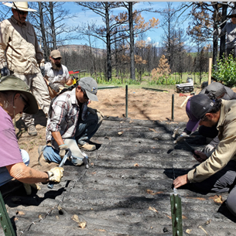
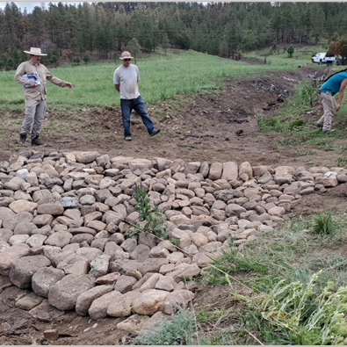
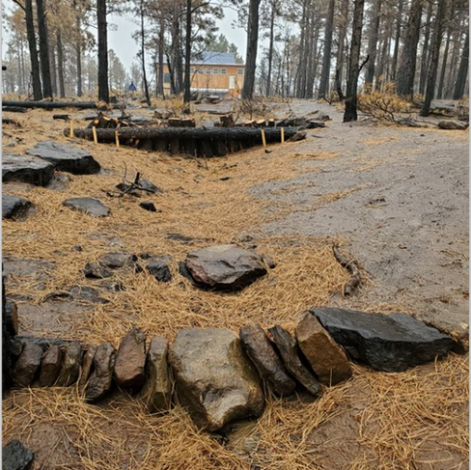
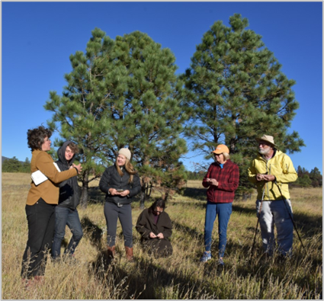
Community Workshops
Luna CC and NMFWRI brought in experts in Post-fire Land Restoration and Wildfire Resiliency to host free community workshops. Topics included erosion control, contour felling, reseeding, post-fire forest thinning, arroyo restoration, and managing burned forests.

Slide 20
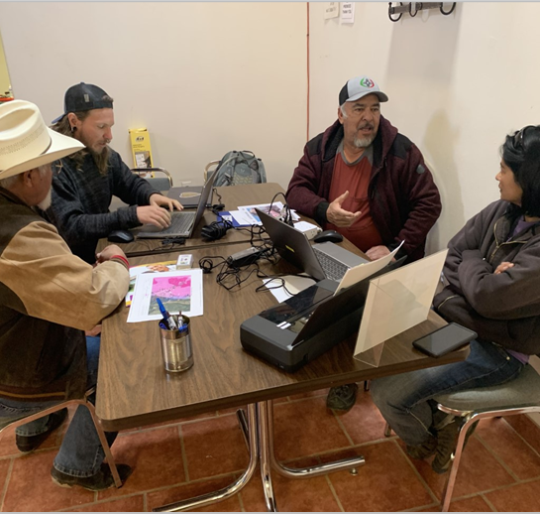
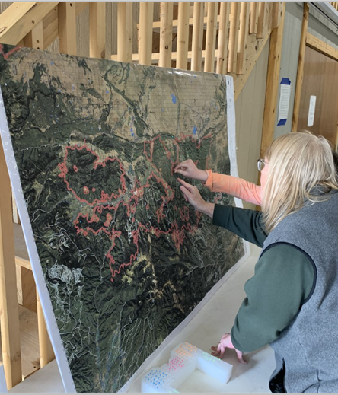
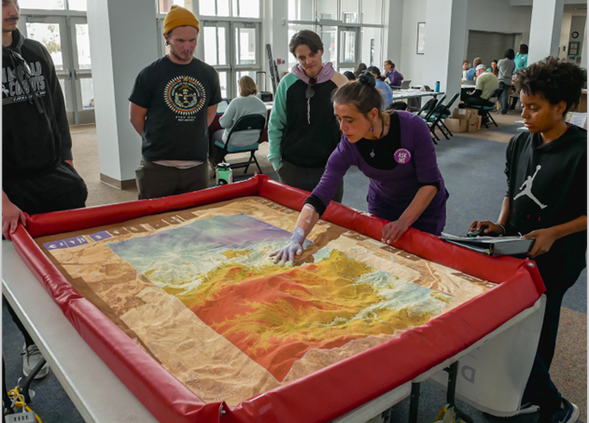
Resiliency Fairs
Six resource fairs were coordinated across two counties focused on continuing to help people with recovery efforts and prepare residents for the coming fire and flood season with practical tips. 10-12 agencies and organizations participated at each fair.

Slide 21
Post-fire Map Creator
An interactive web-based mapping tool built for those impacted by the HPCC fire to create maps and generate reports showing the impacts the fire had on their property.

Slide 22
HPCC ArcGIS Hub Support Timeline
HPCC fires merge and spread
Fire response & containment
Fire recovery, post-fire flooding
Community rebuilding
Long term recovery
NM Fire Viewer
Cooperator’s Hub
Public Hub
Workshops &
Map Creator
HPCC Hub Site
Evacuation zones, fire perimeters, thermal hotspot detections, building footprints, land ownership, vegetation treatment information.
Public map consolidating available relevant data and embedded social media updates, information and resources.
Resource and contact information for long term recovery group, calendar of upcoming and recorded community events.
Collaborative mapping replaces static maps. Controlled access communication and data portal.
Community workshops covering post-fire restoration topics, resiliency fairs, and a public map creator tool.

Slide 23
Lessons Learned
Effective Collaboration Tool
Spokesperson/ POC for groups
Security/permission controls facilitated agency use
Need traffic control/gatekeeper for requests
Data sharing and ownership issues
ArcGIS Hub Premium vs. Basic
Web design expertise helpful

Slide 24
Lessons Learned
Effective Collaboration Tool
Spokesperson/ POC for groups
Security/permission controls facilitated agency use
Need traffic control/gatekeeper for requests
Data sharing and ownership issues
ArcGIS Hub Premium vs. Basic
Web design expertise helpful

Slide 25
What’s Next
Templates!
Fire is a part of our landscape going forward and we want to share this type of technology/tool for quick stand up during an event. We are looking for testers!

Slide 26
Contact Information
nmfwri.org
Dana Heusinkveld
dheusinkveld@nmhu.edu
Patti Dappen
prdappen@nmhu.edu
Staci Matlock
stacimatlock@nmhu.edu
Stop by our booth!

Slide 27
Thank You!
Questions?

