Slide 1
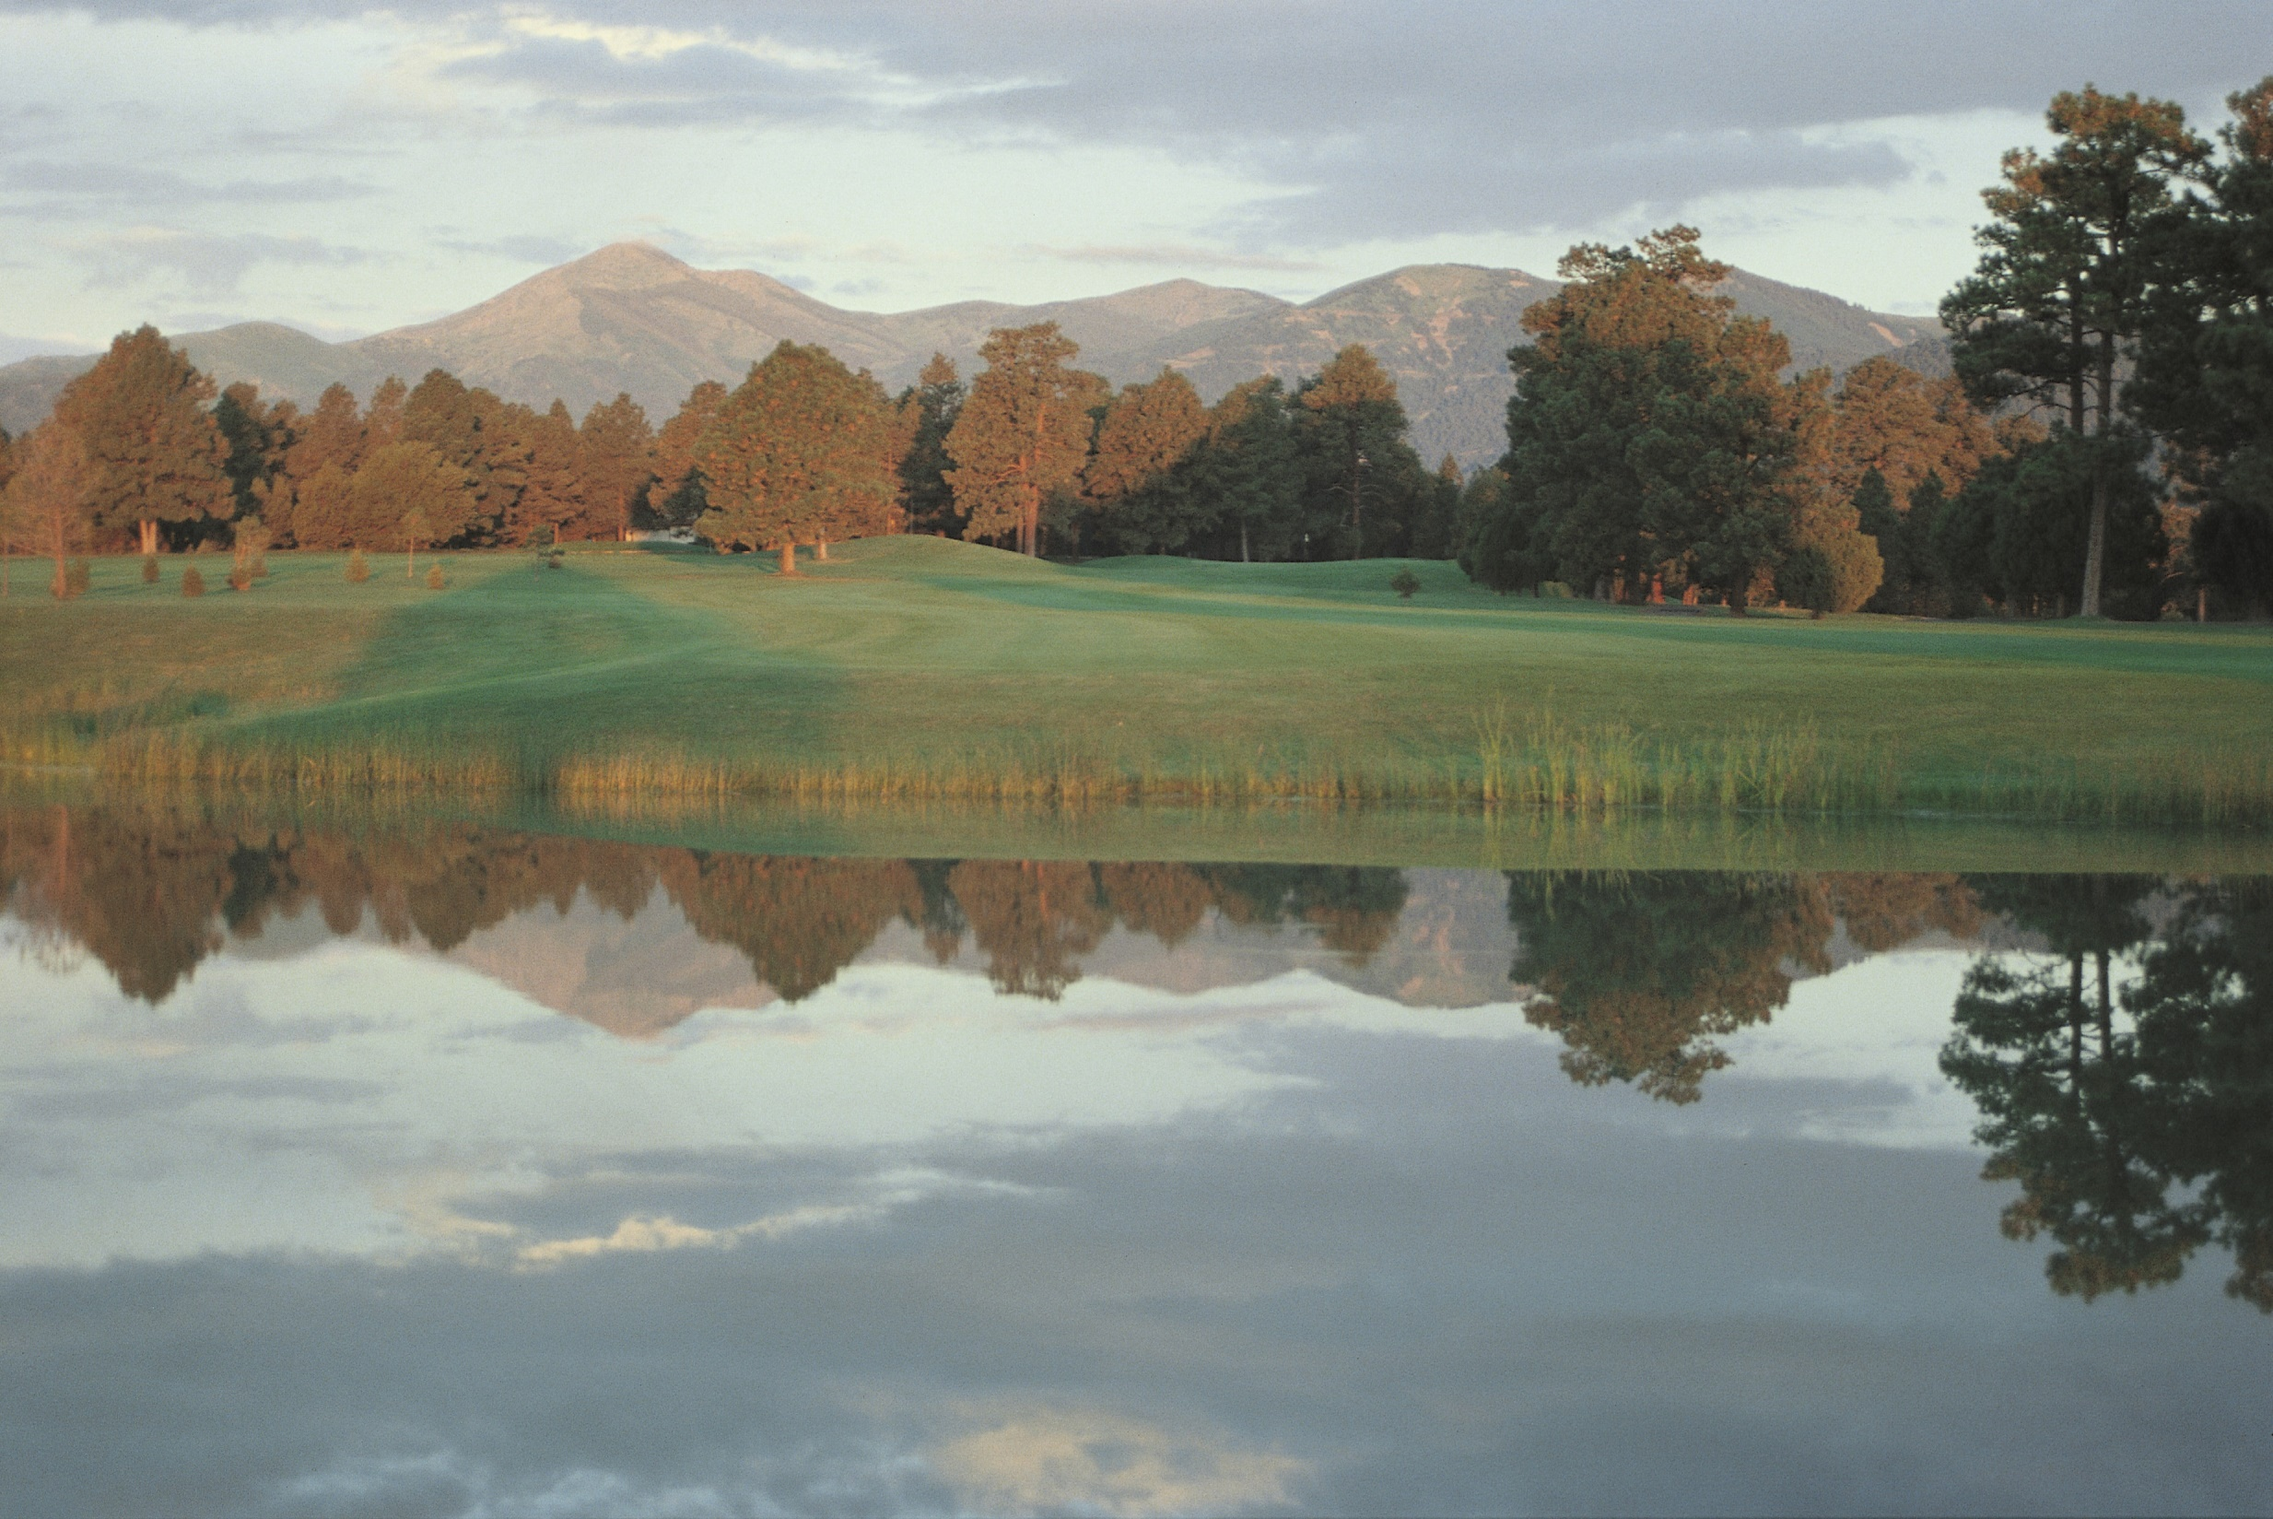

Slide 2
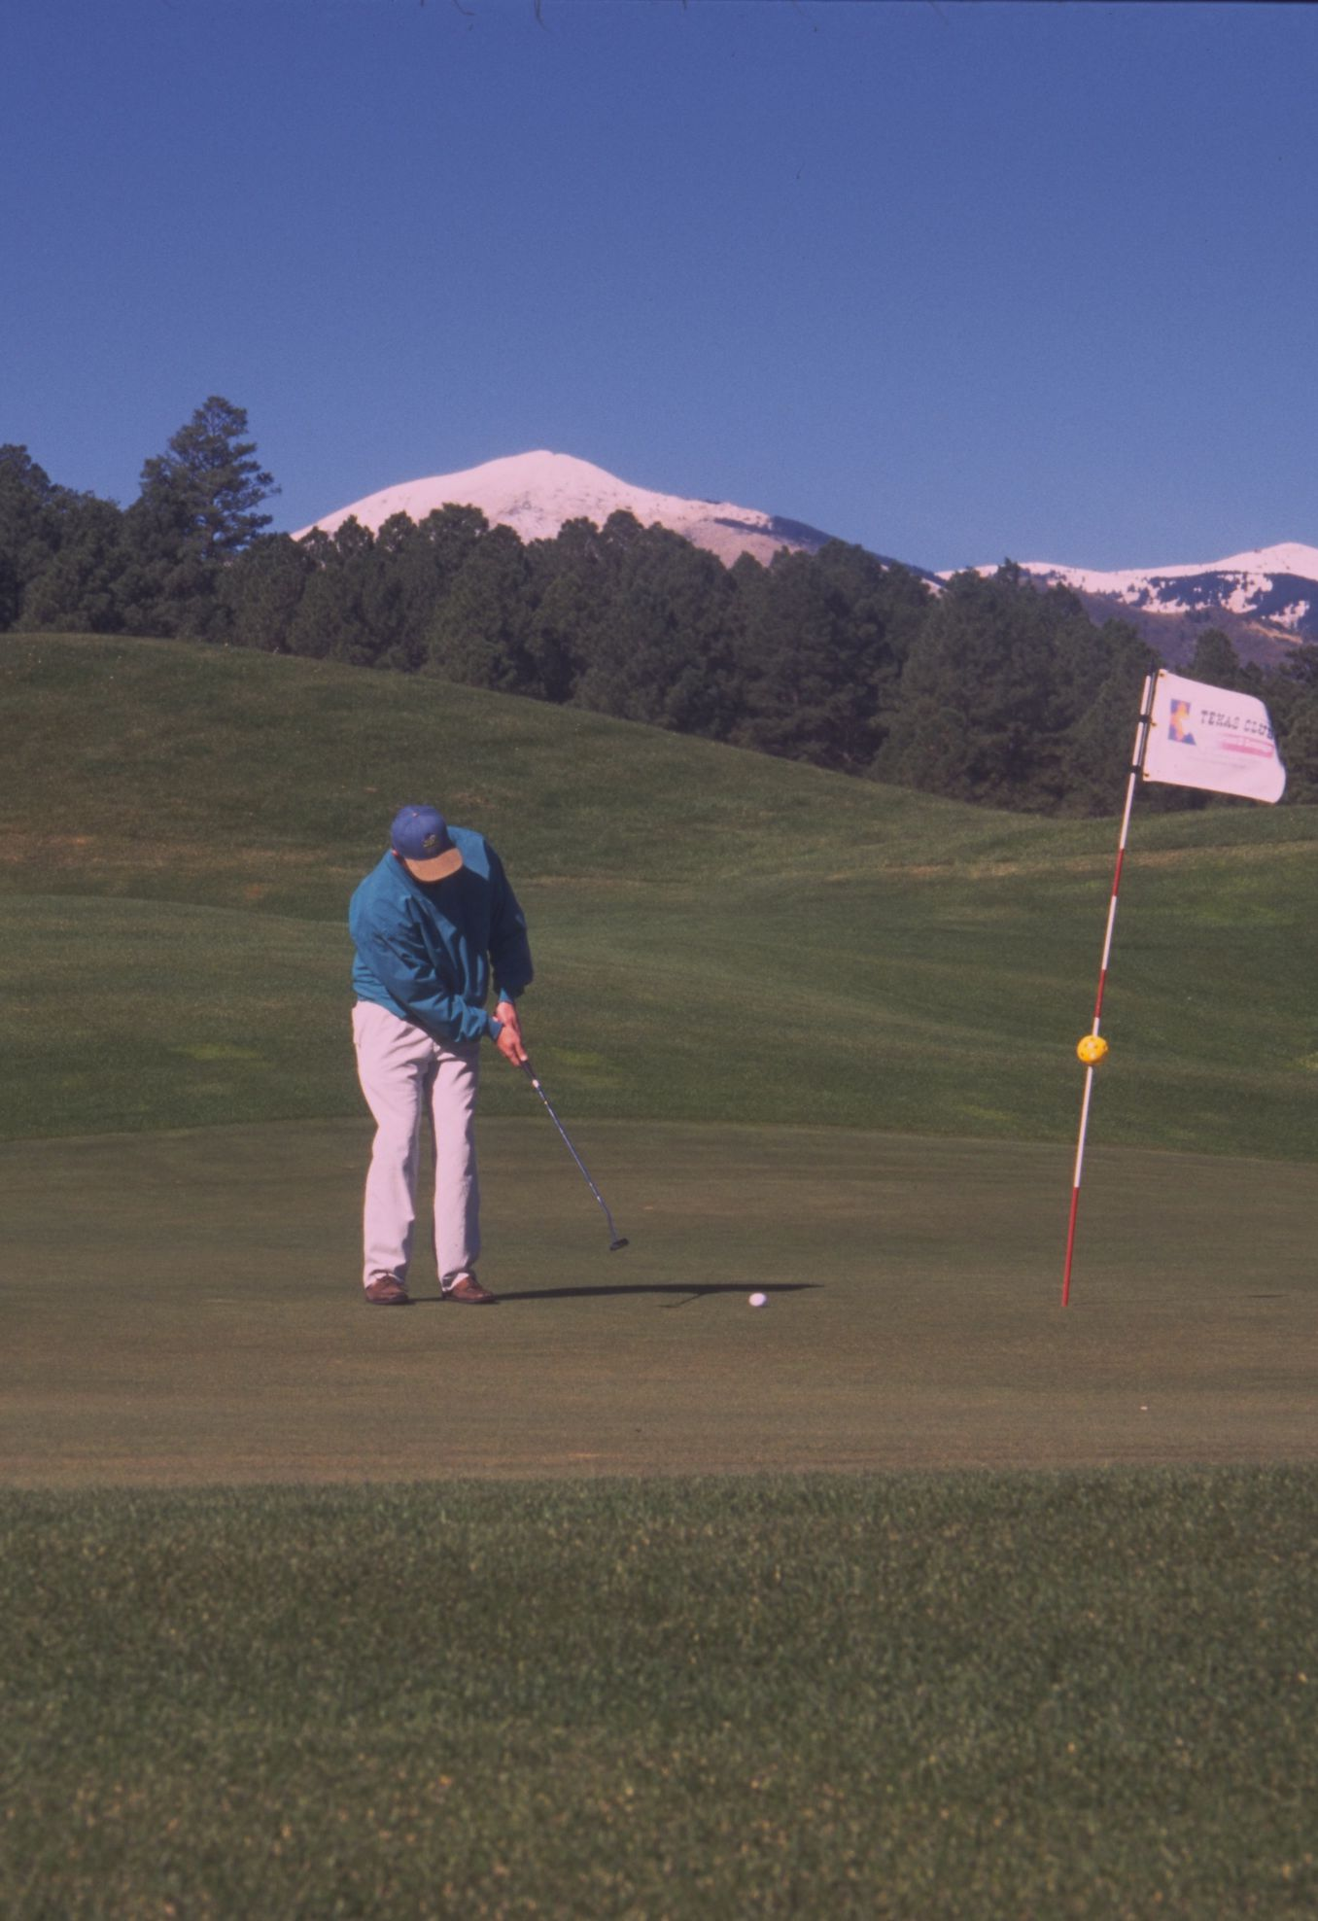
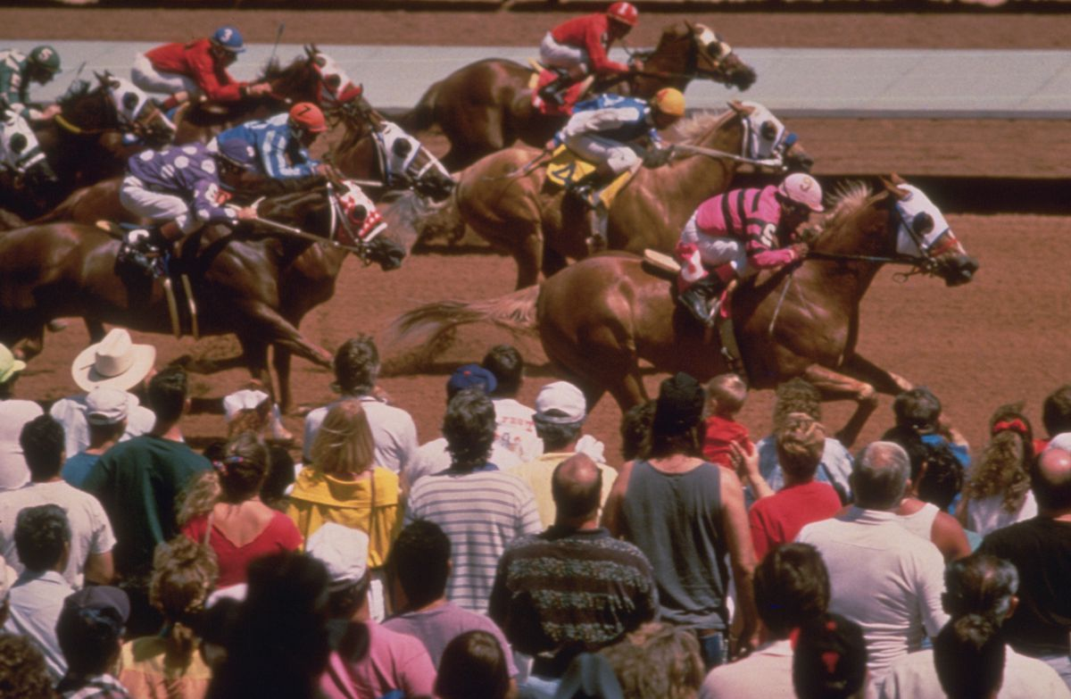
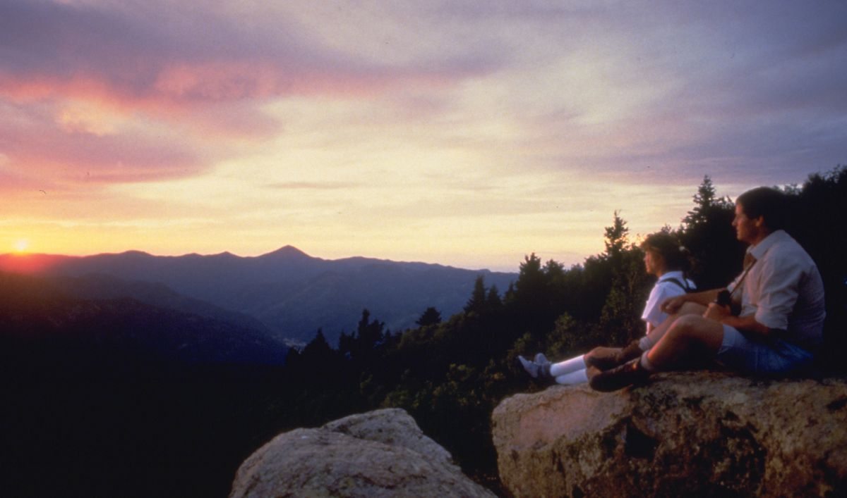

Slide 3
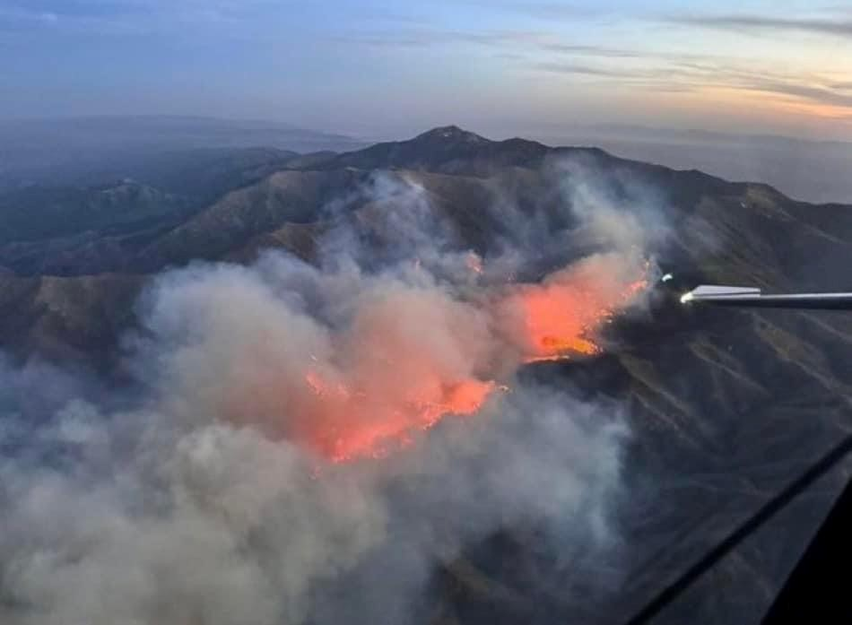
BLUE 2 FIRE

Slide 4
BLUE 2 FIRE
May 16, 2024

Slide 5
BLUE 2 FIRE
May 16, 2024
One week before
Memorial Day Weekend

Slide 6
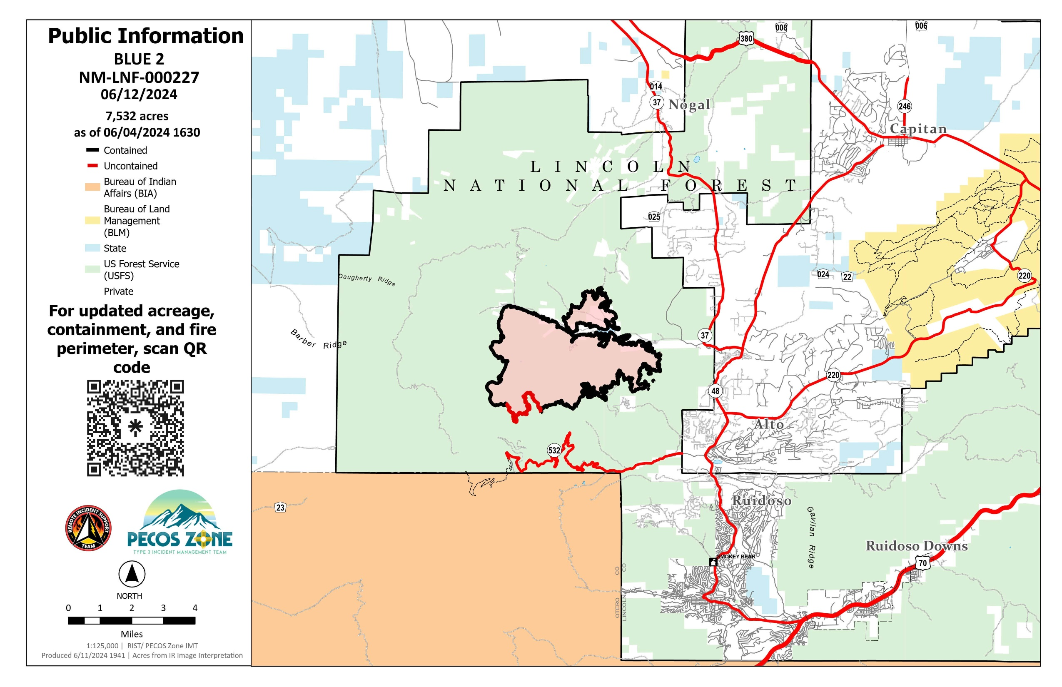

Slide 7
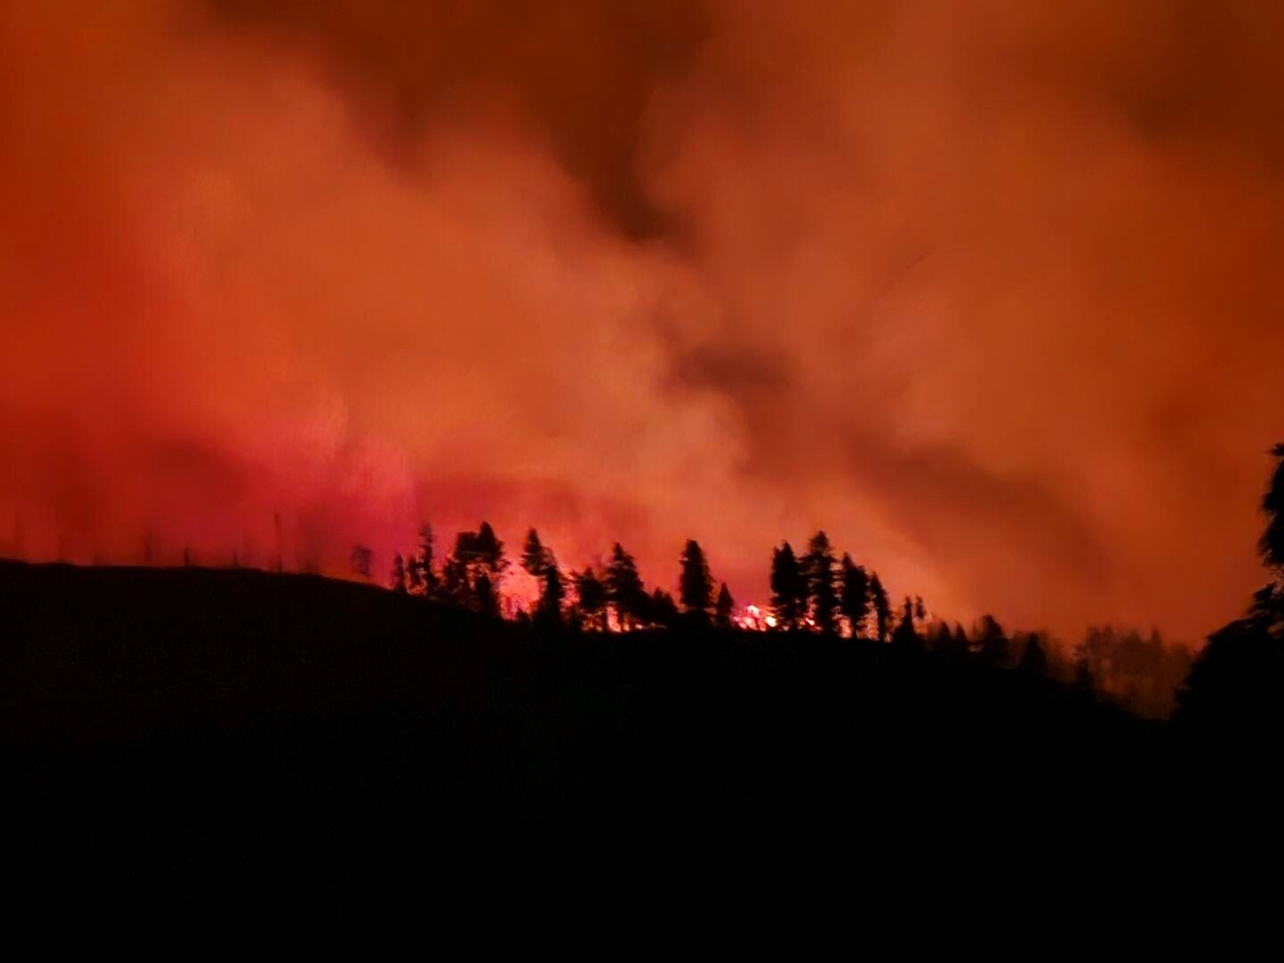
BLUE 2 FIRE
7,532 Acres Burned
Start Date: May 16, 2024
91% Containment on June 12, 2024
8% Moderate Burn Severity with No High Burn Areas

Slide 8
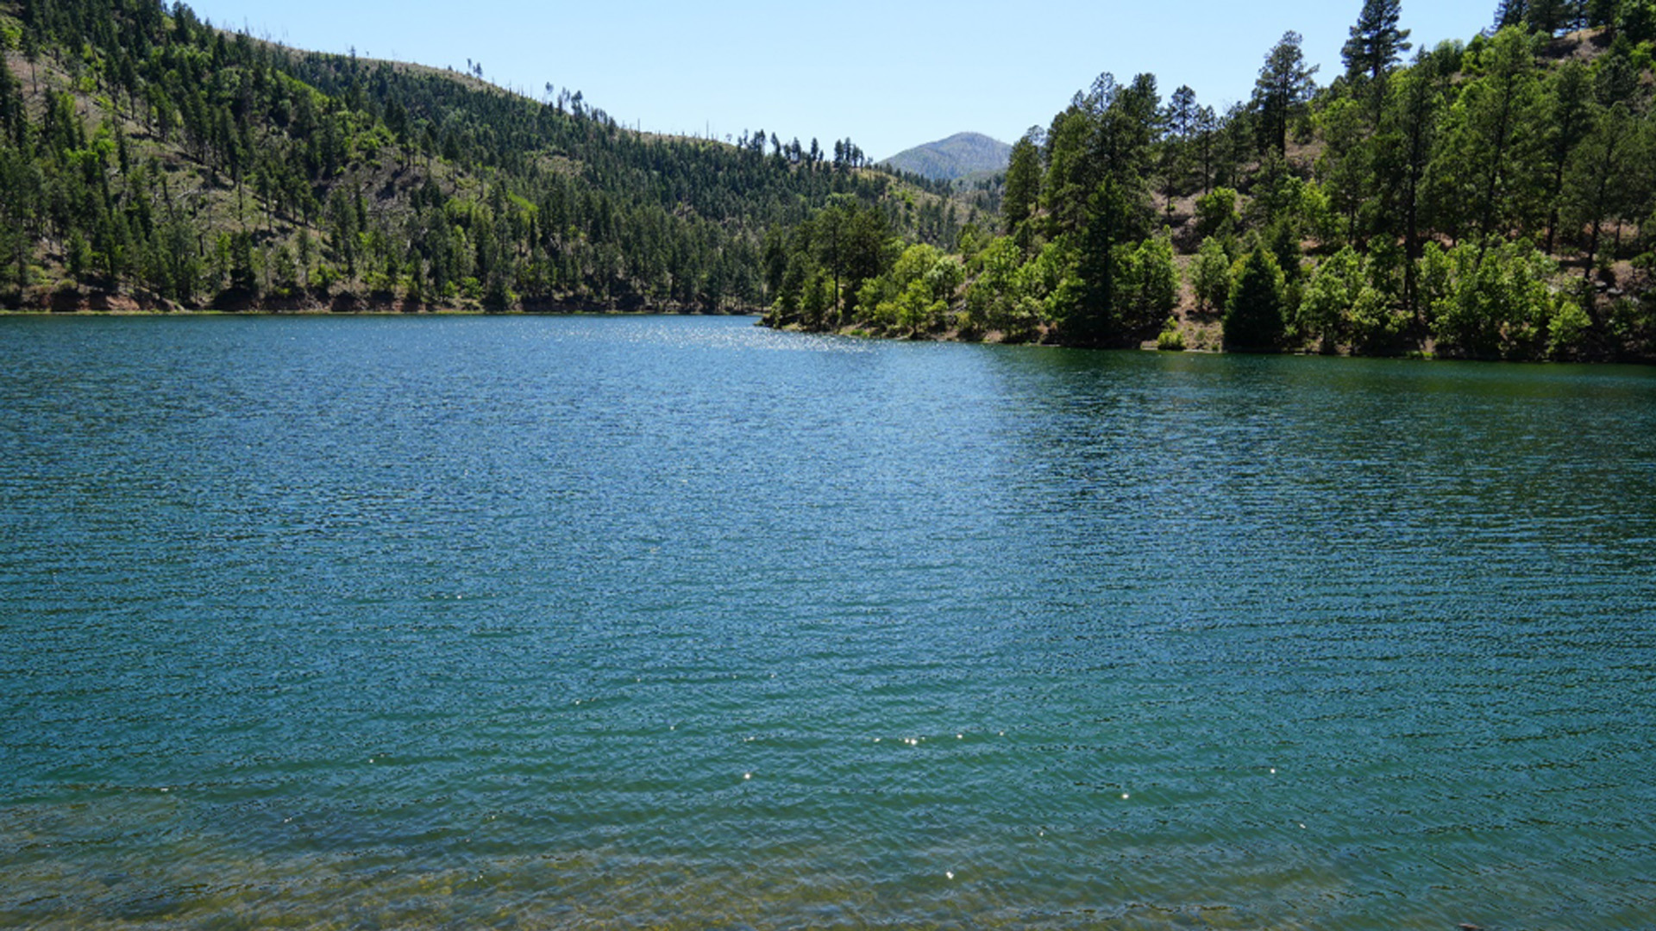
Bonito Lake reopening for fishing after over a decade of post-fire cleanup…

Slide 9
Bonito Lake reopening for fishing after over a decade of post-fire cleanup…
Just kidding

Slide 10
Bonito Lake reopening for fishing after over a decade of post-fire cleanup…
Just kidding
$1.5 Million in Emergency Watershed Protection funds to protect the lake

Slide 11
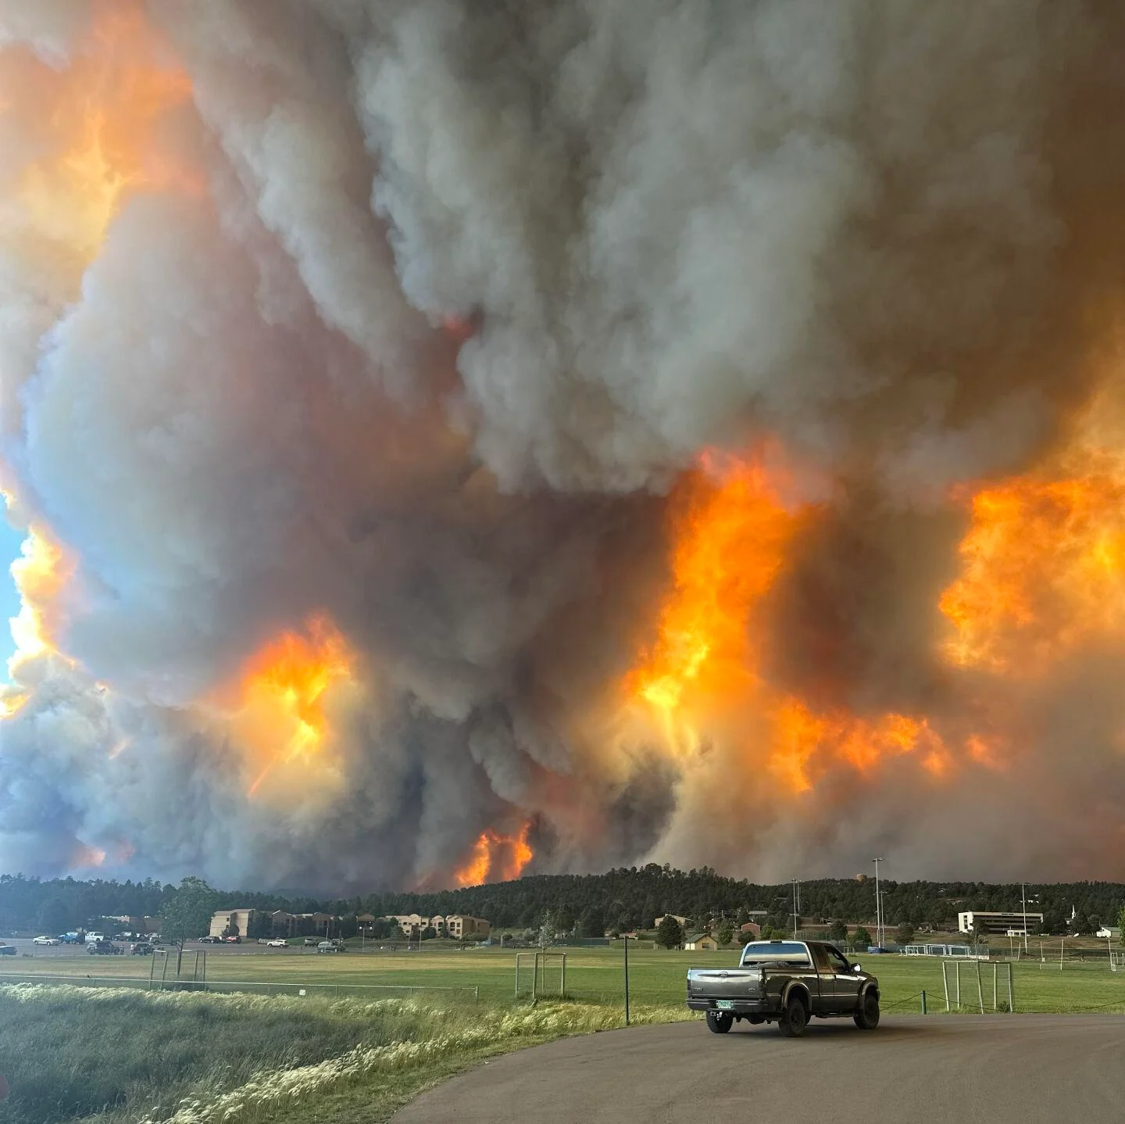
South Fork & Salt Fires
June 17, 2024

Slide 12
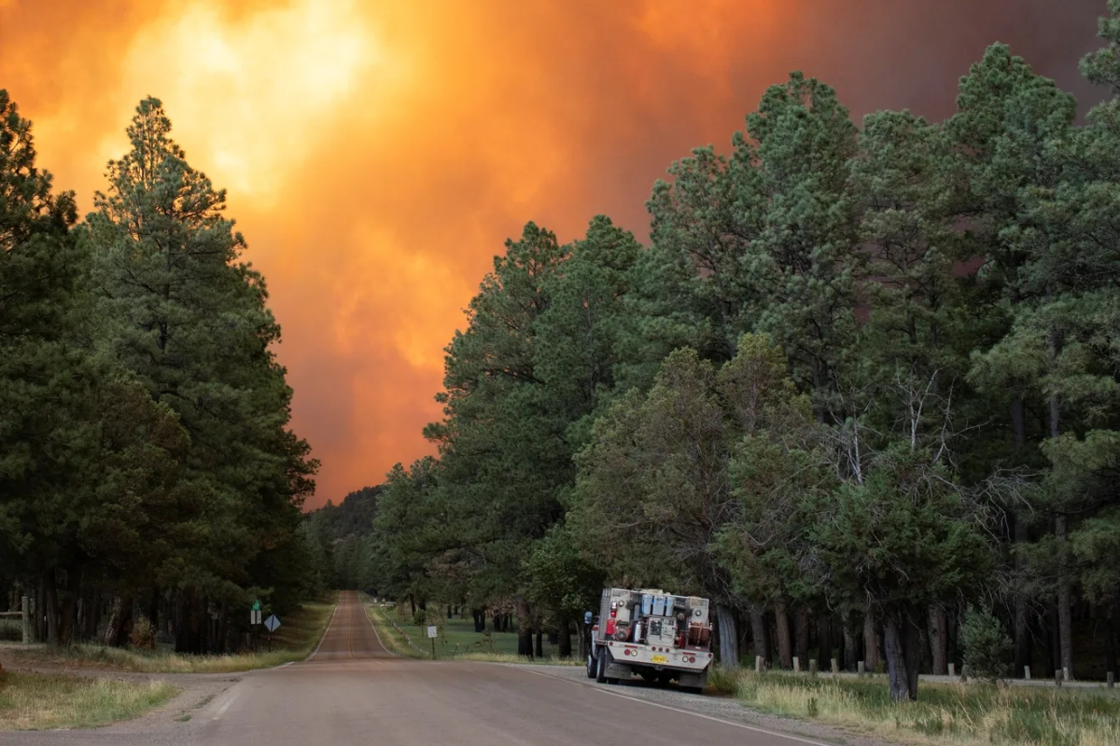

Slide 13
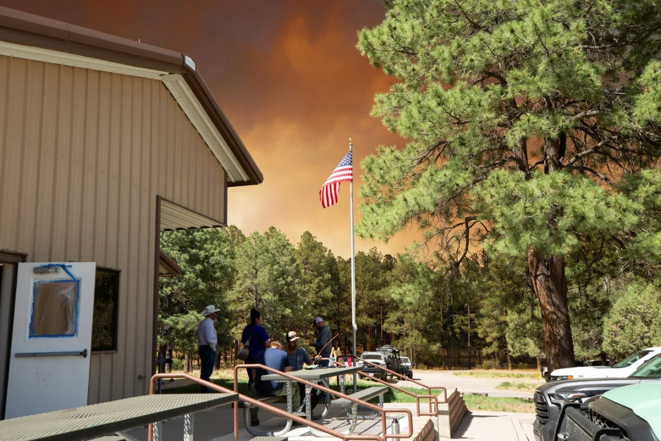
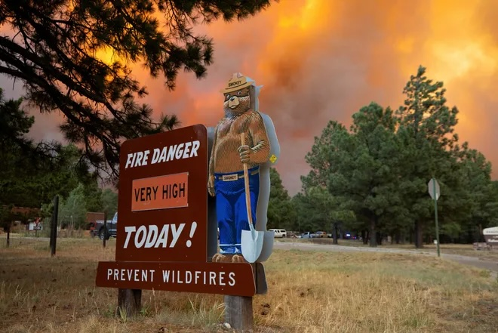

Slide 14
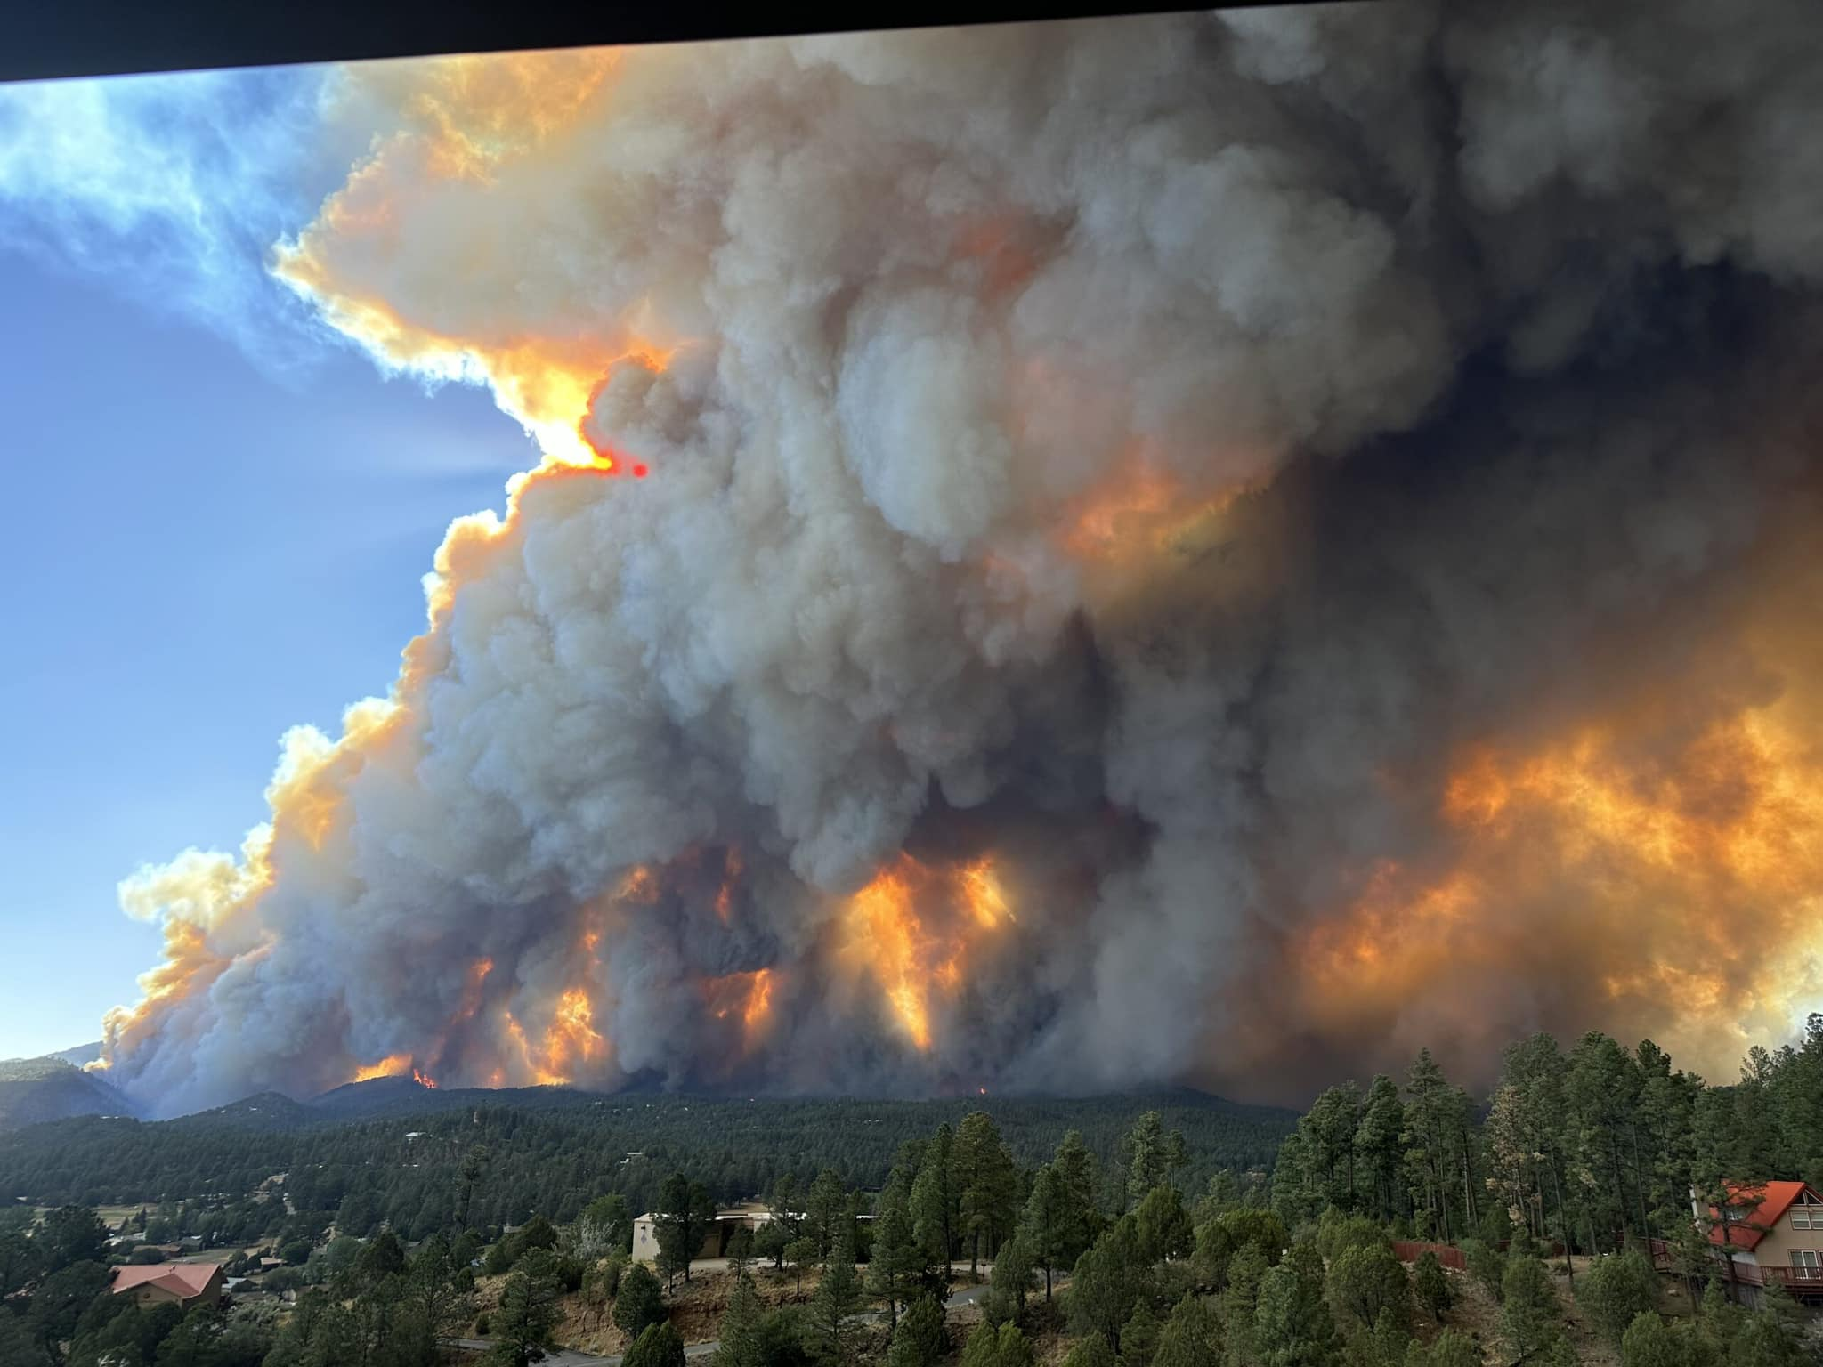

Slide 15
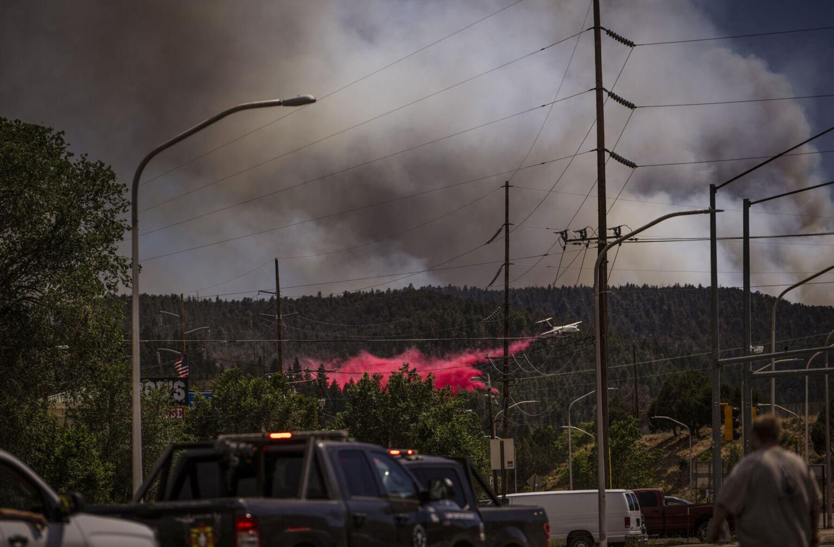

Slide 16
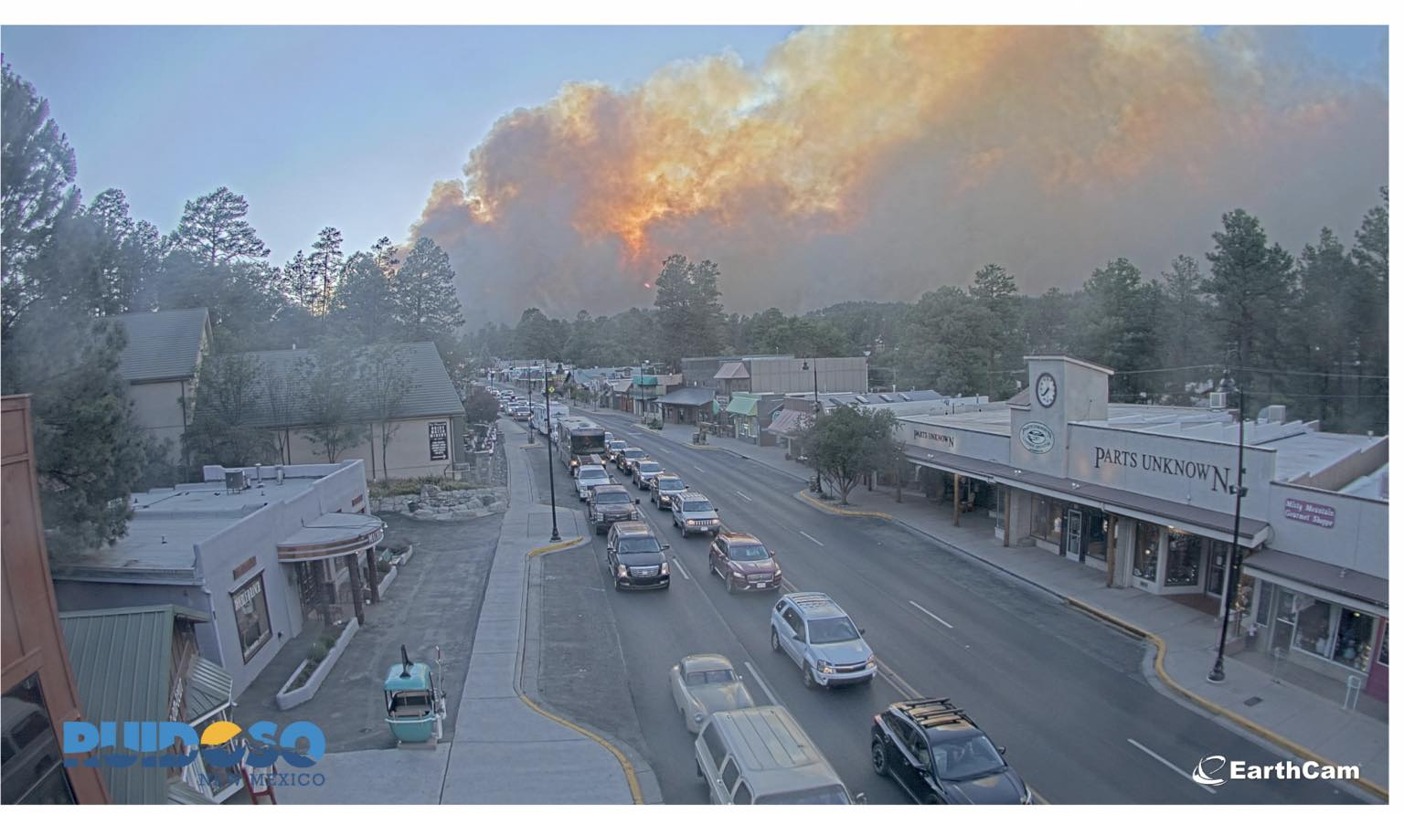

Slide 17
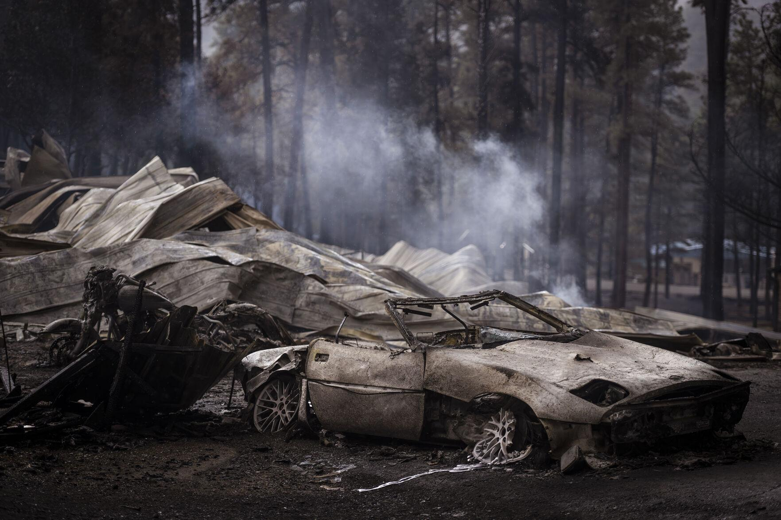

Slide 18
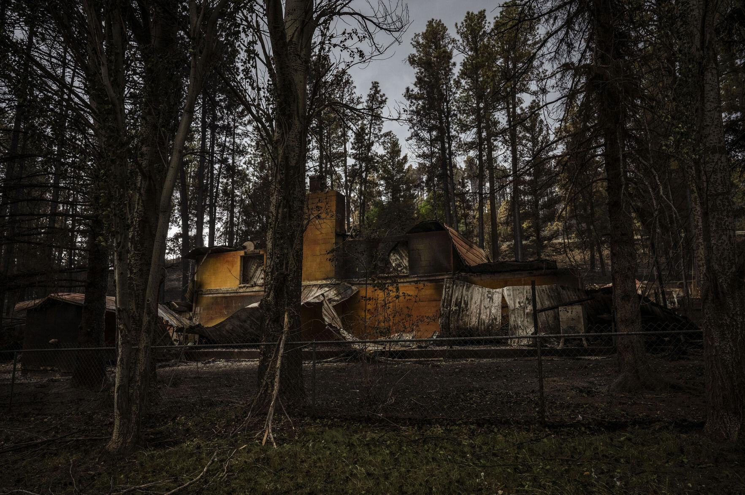

Slide 19
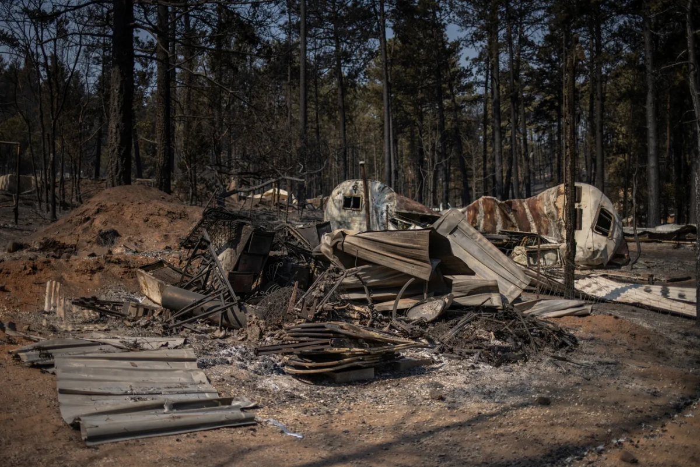
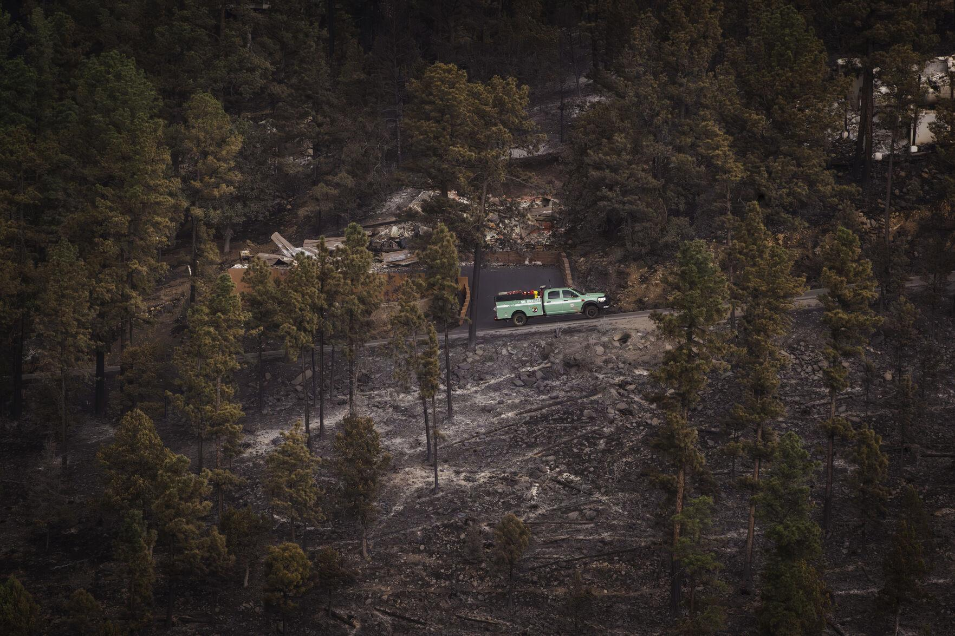

Slide 20
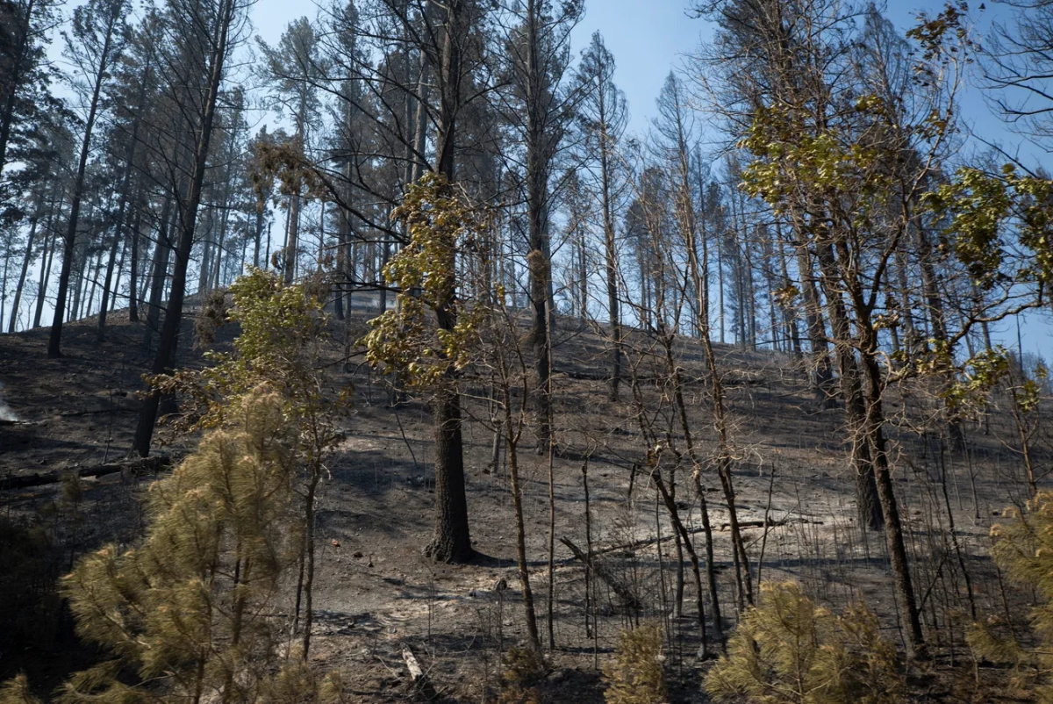
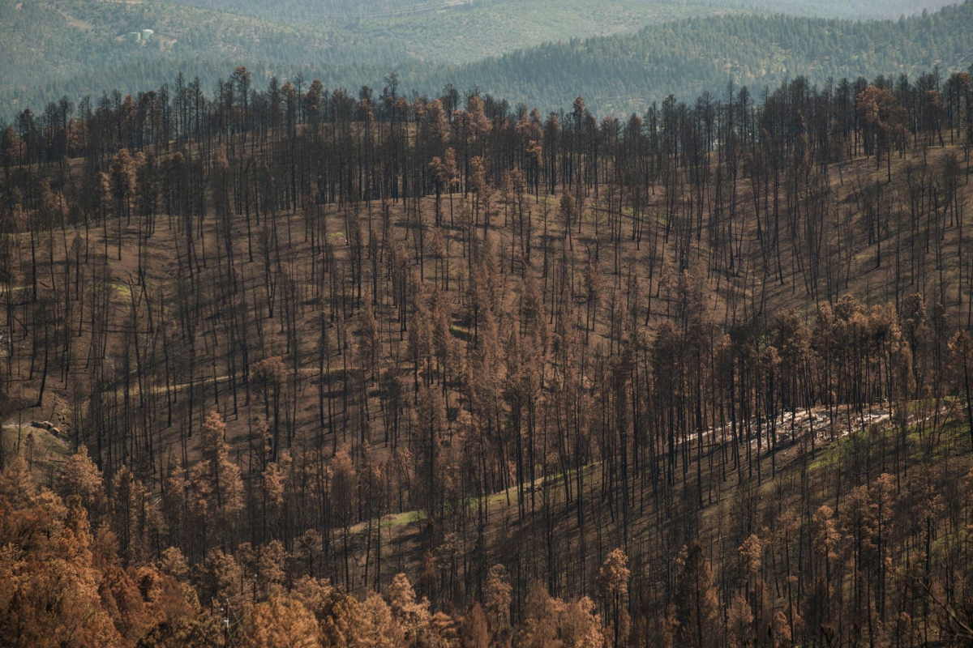

Slide 21
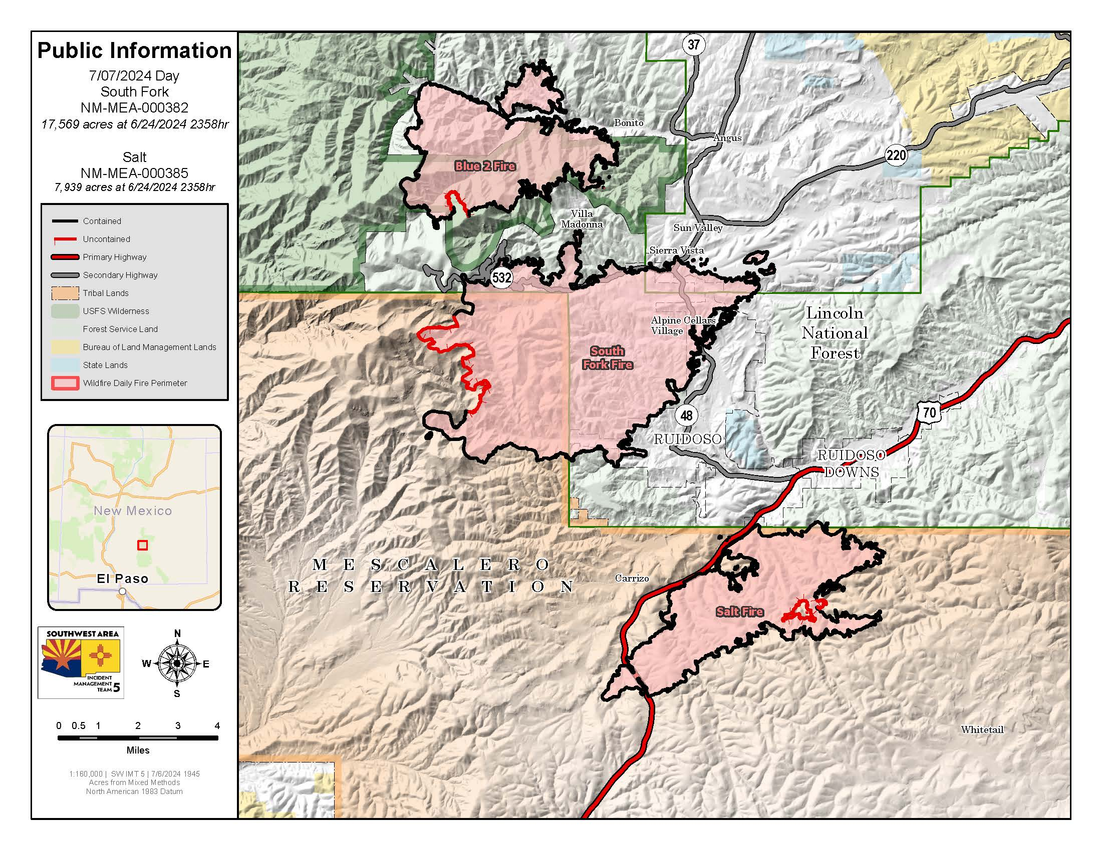

Slide 22
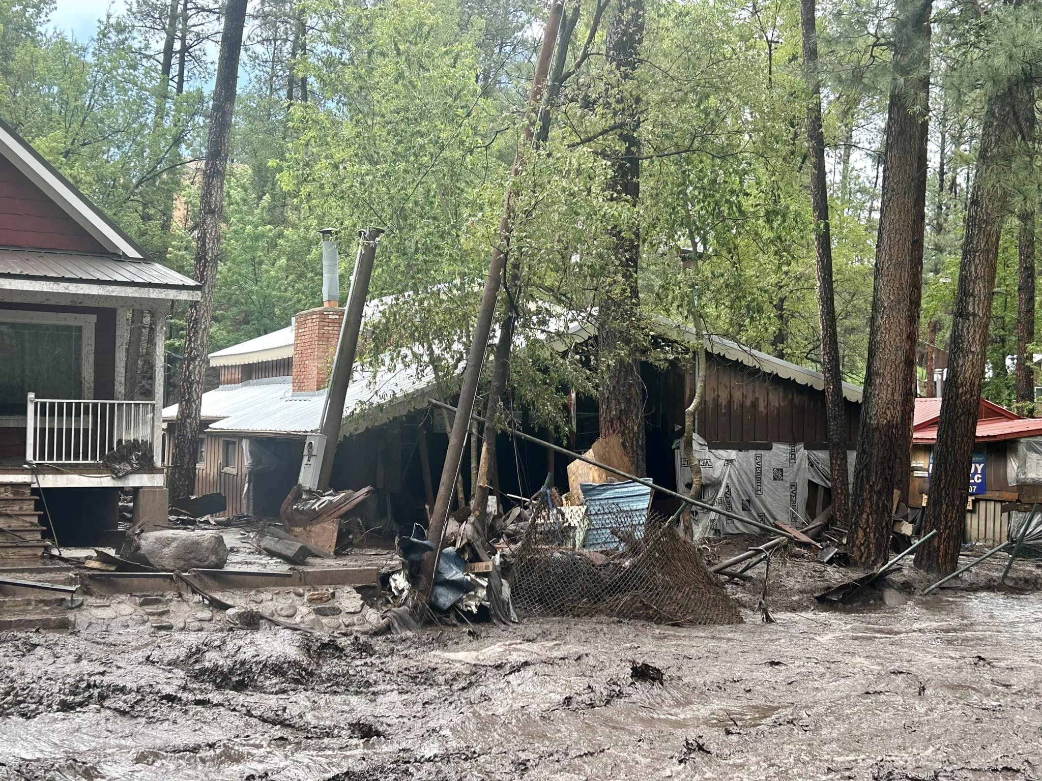

Slide 23
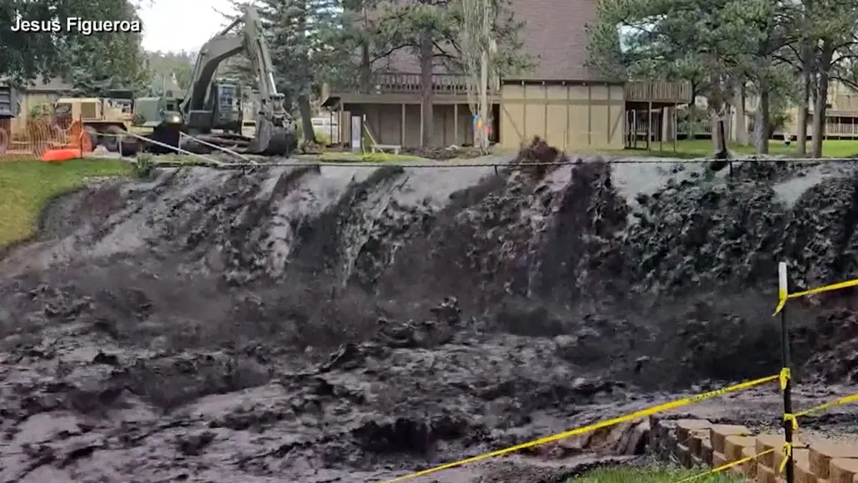

Slide 24
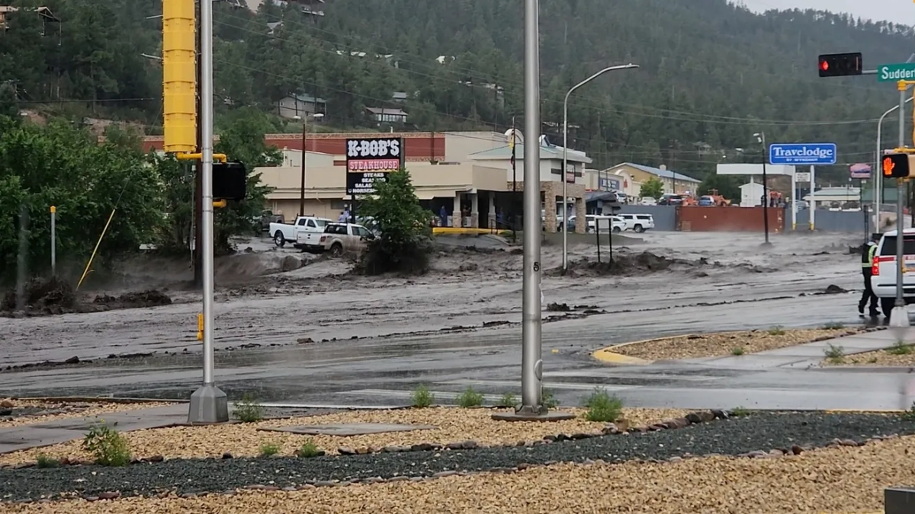
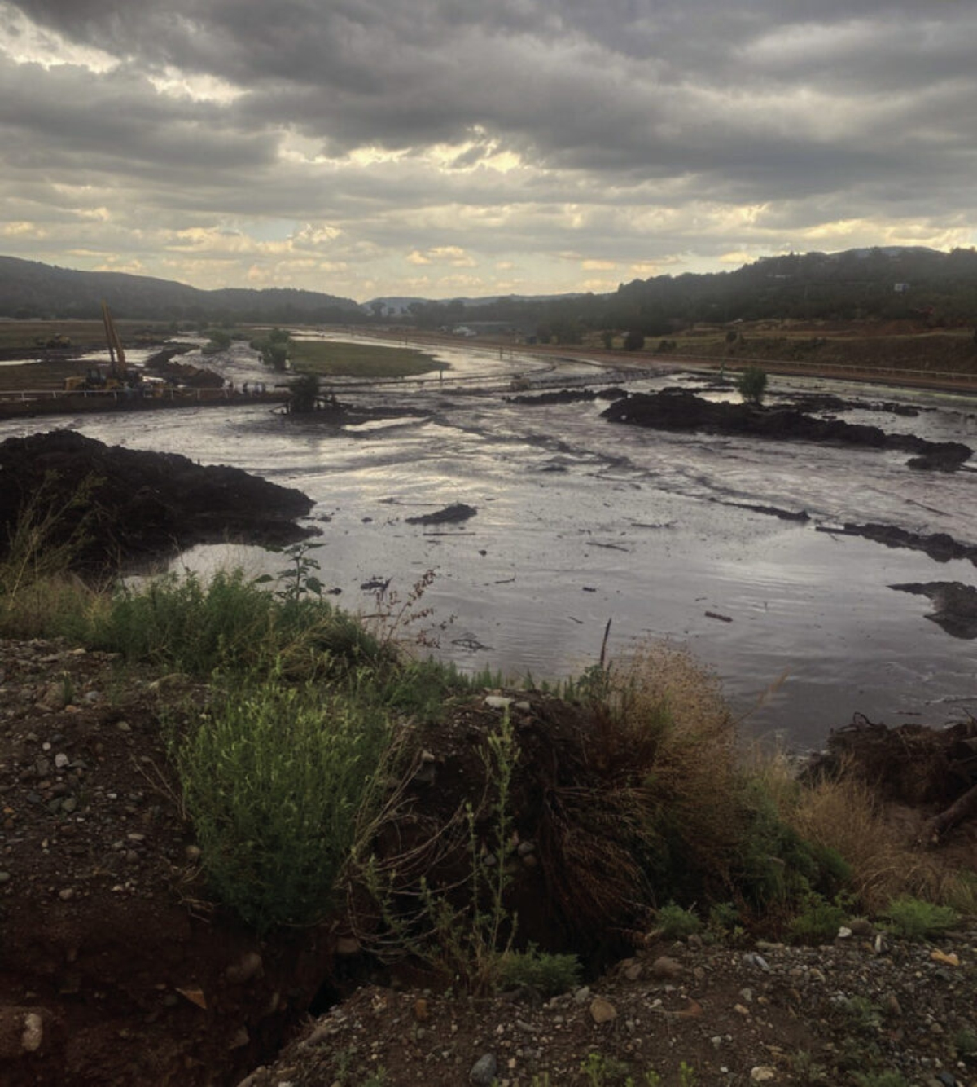
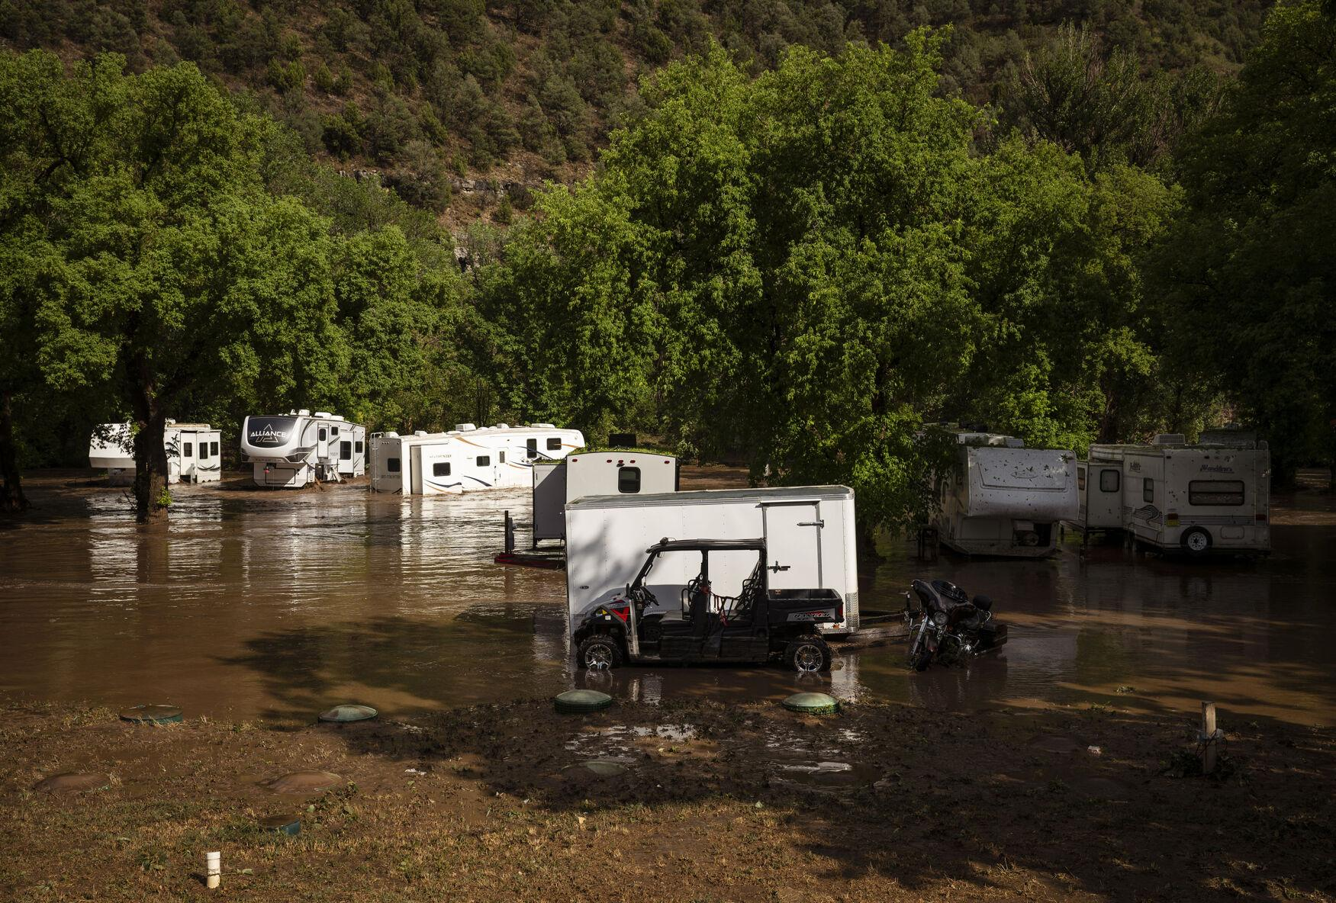

Slide 25
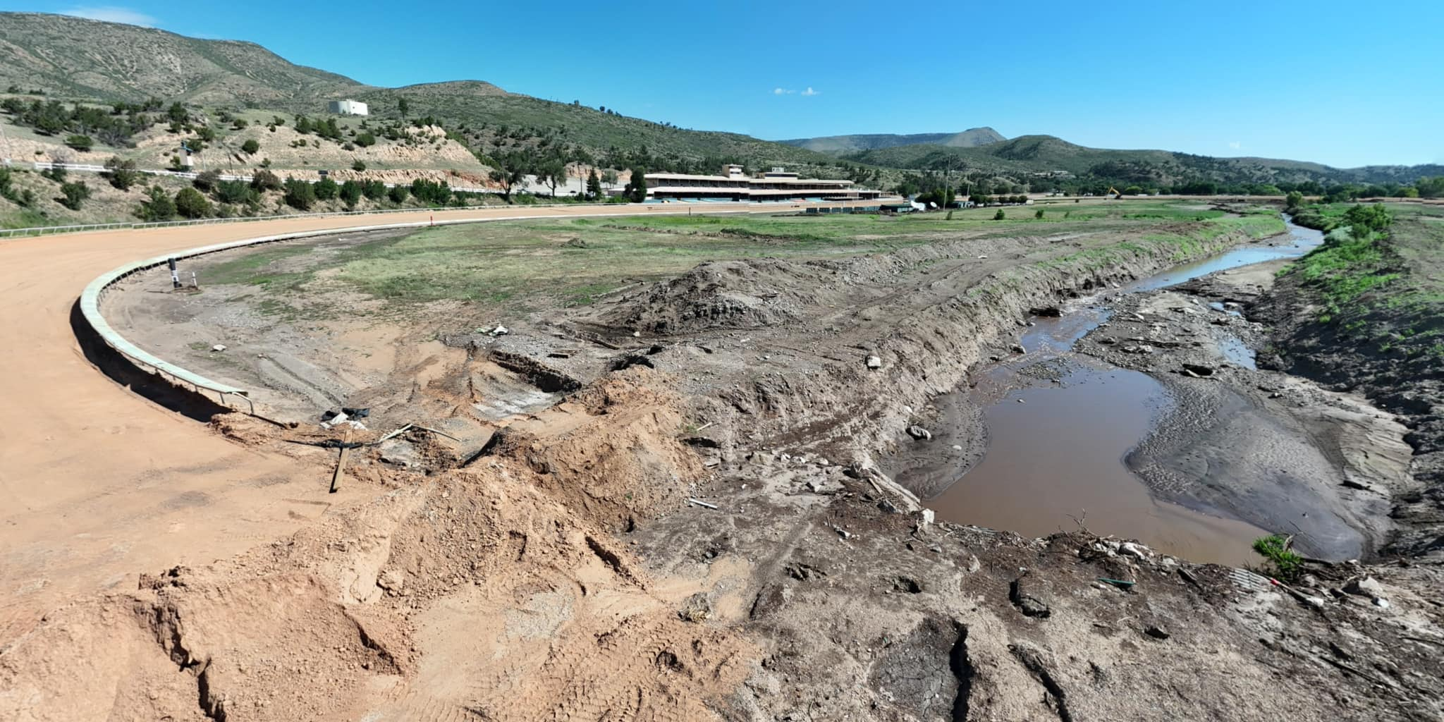
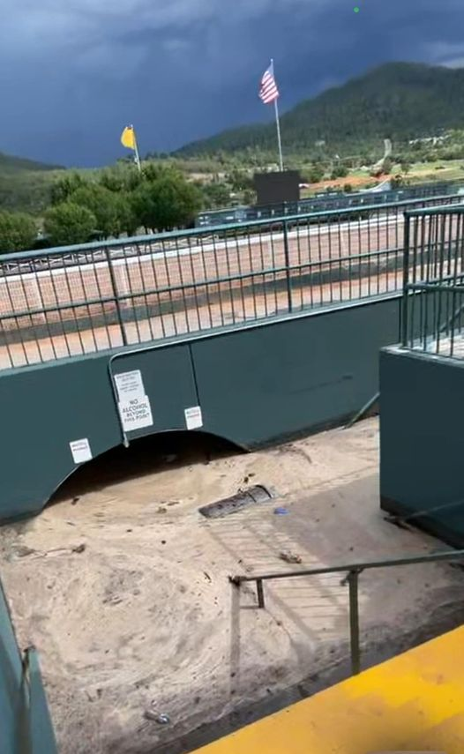
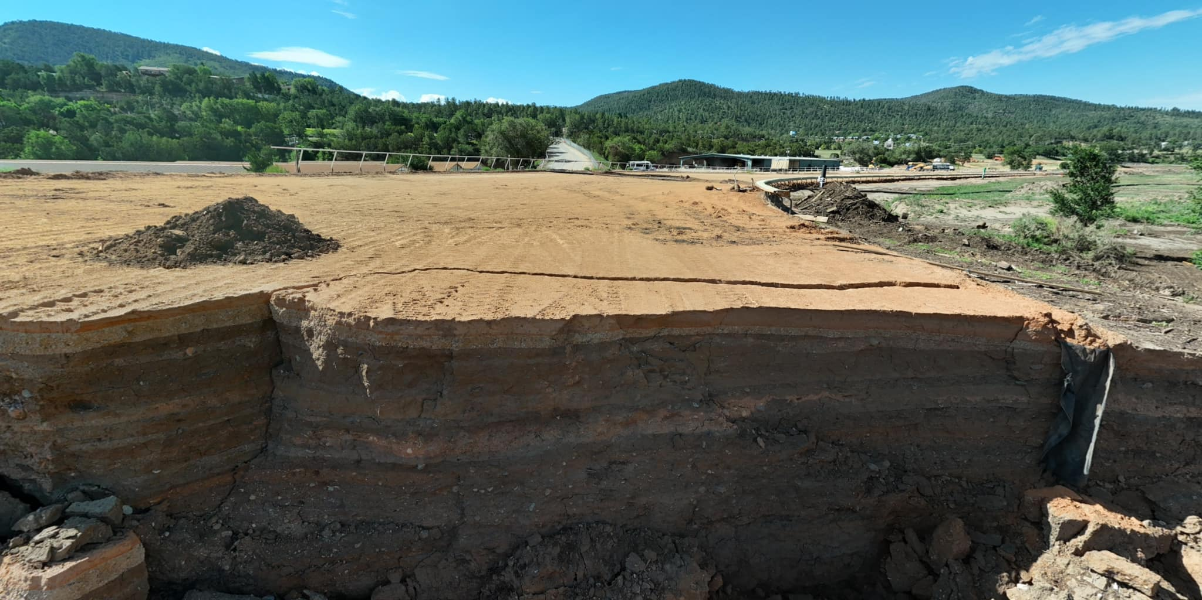

Slide 26
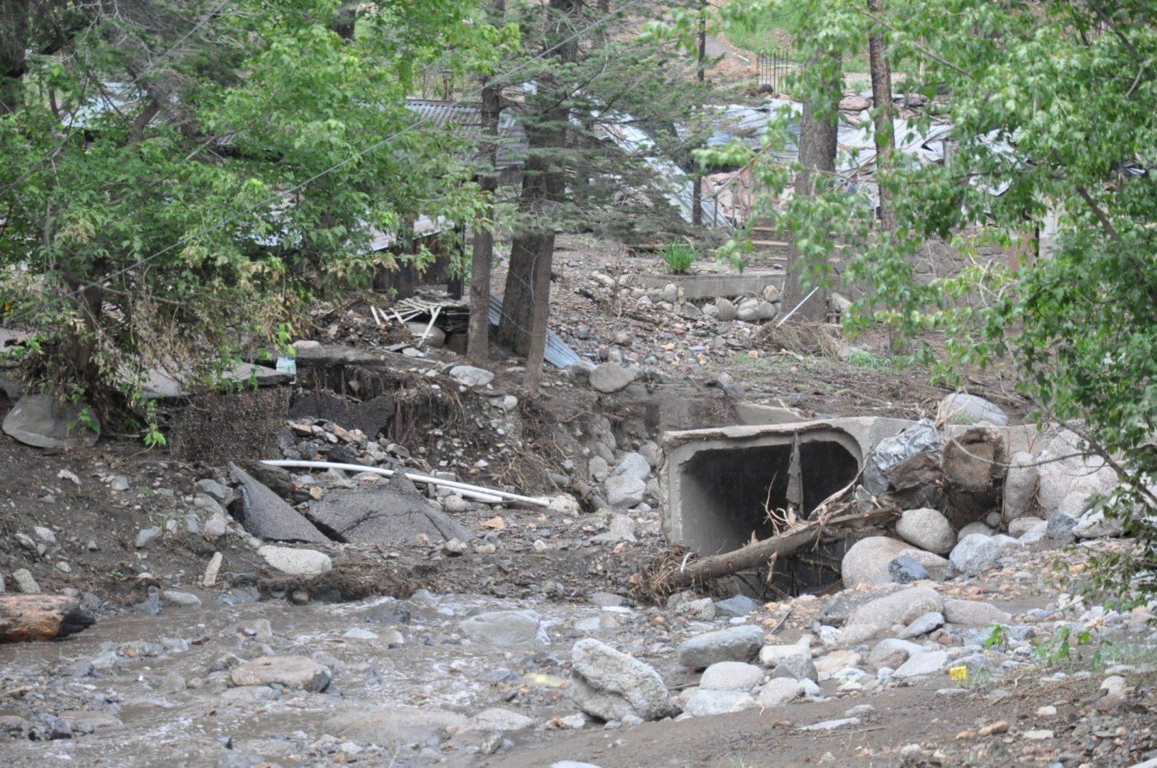
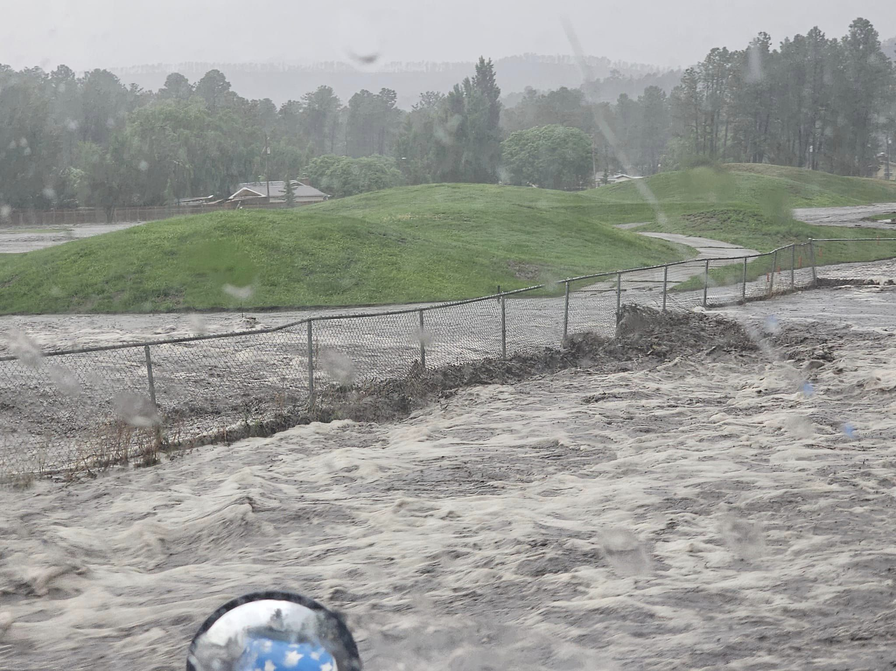

Slide 27
Ruidoso Area Summer of 2024
Blue 2 Fire – 7,532 Acres
South Fork Fire – 17,569 Acres
Salt Fire – 7,071 Acres
Combined Fire Acreage in Ruidoso Area – 32,172
Containment Date: July 15, 2024
South Fork Fire:
1391 Structures Destroyed including 973 Homes
197 Structures Damaged

Slide 28
Unexpected Impacts
Ruidoso Downs Race Track moved race meet to Albuquerque
Midtown Merchants report sales down 80-90%
Loss in gross receipts taxes
Budget impacts due to loss of tax base
Start of school delayed with new flood potential protocols in place
Emotional and Financial Stress

Slide 29
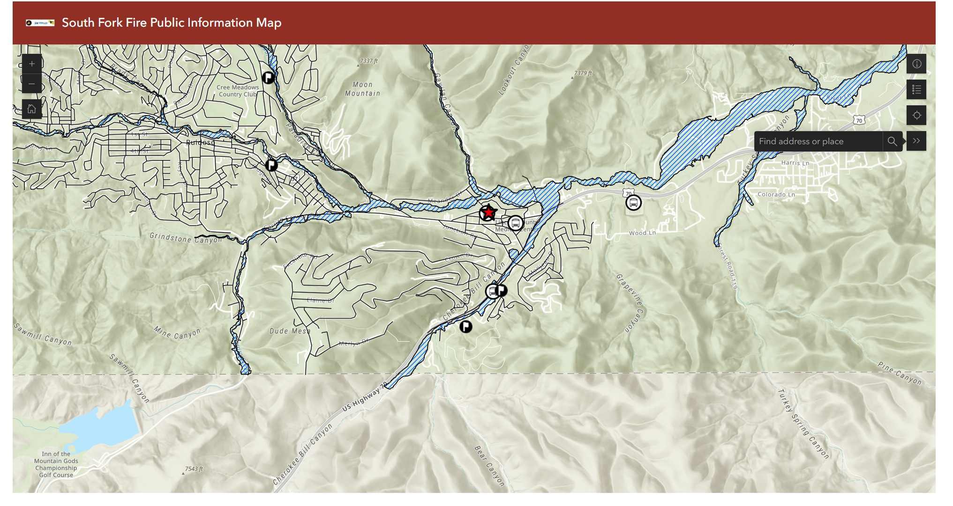

Slide 31
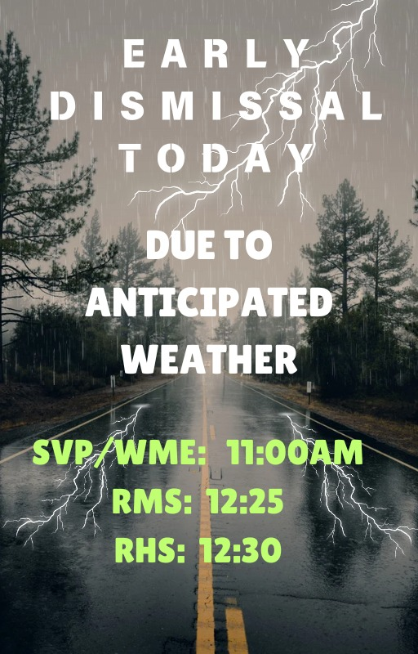

Slide 32
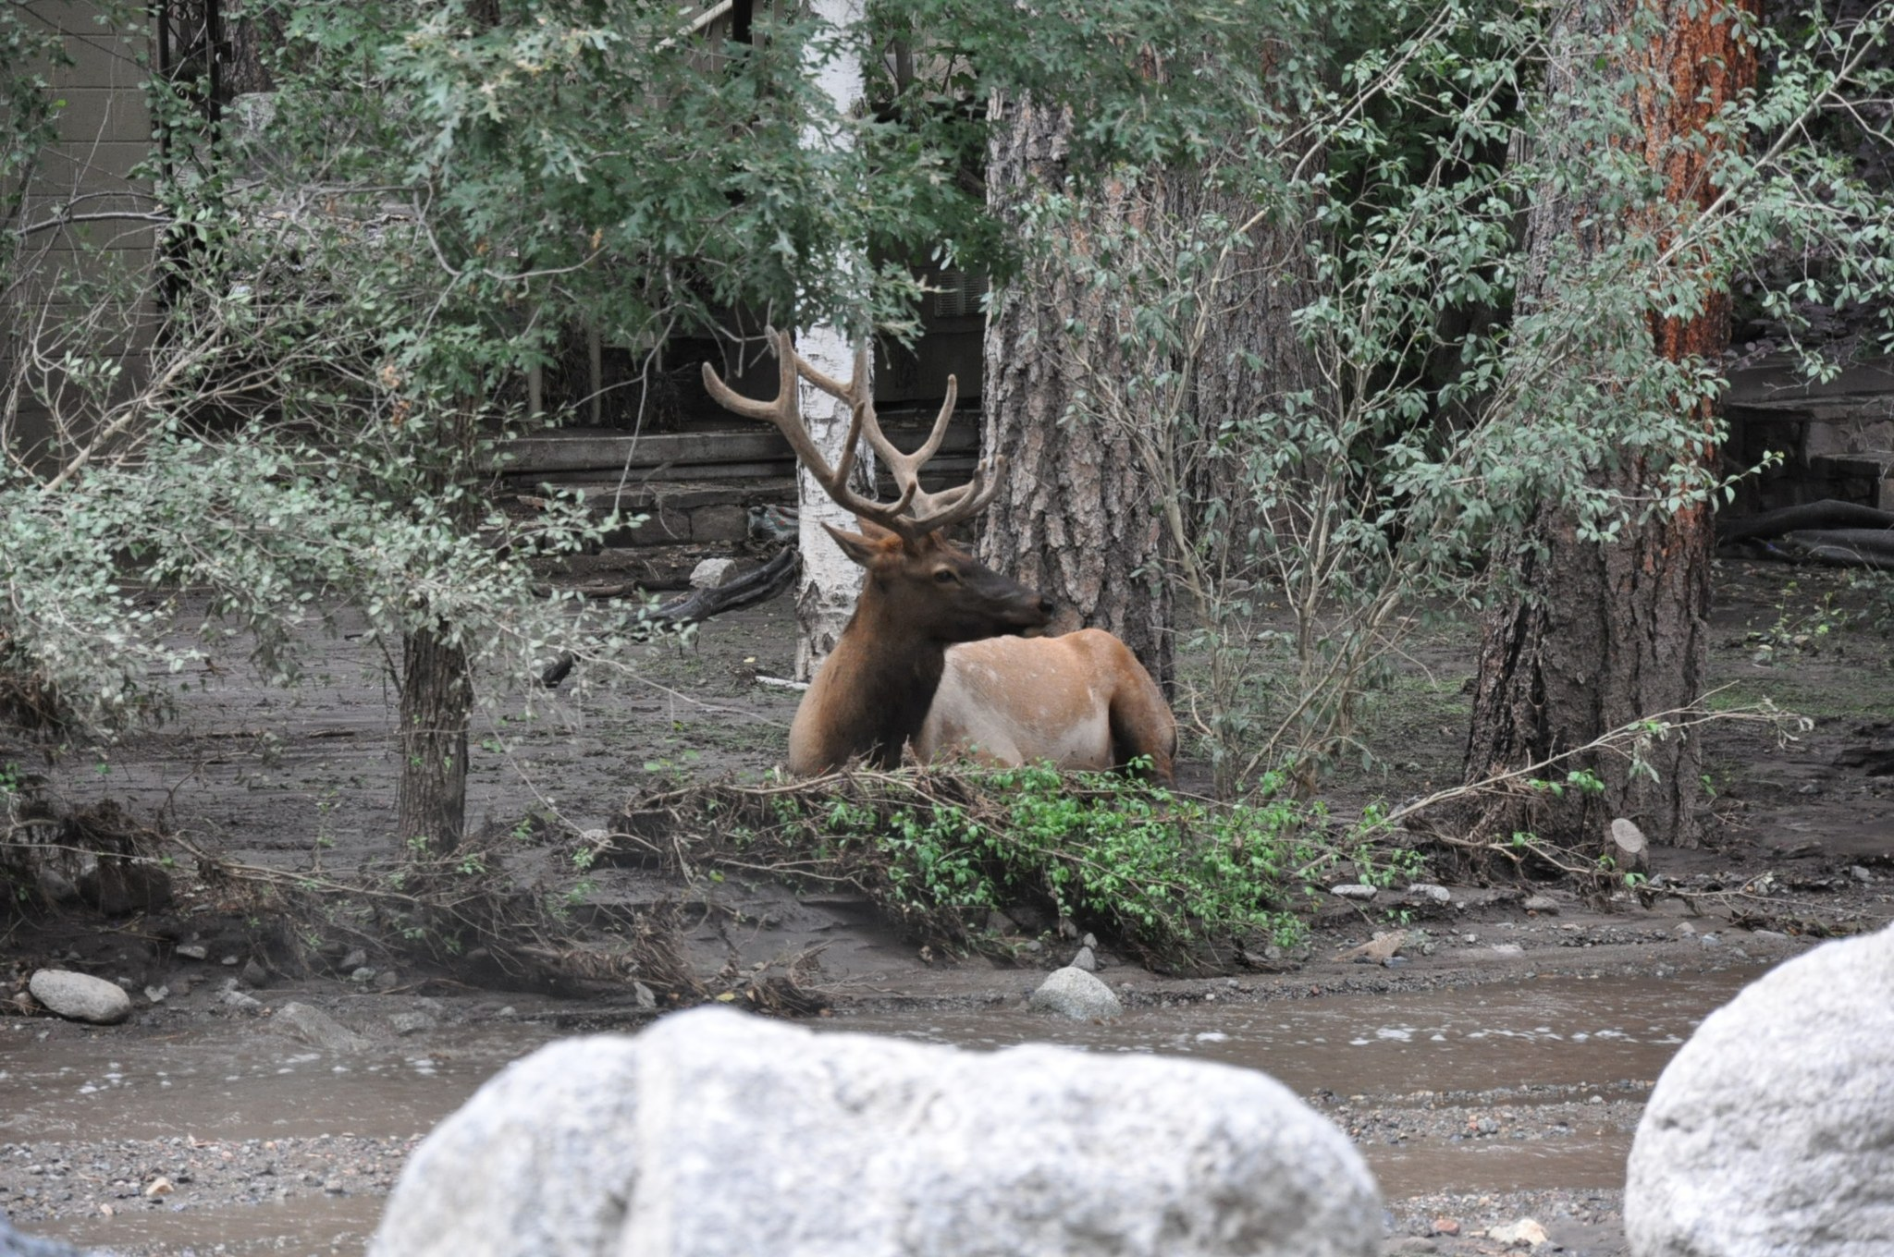

Slide 33
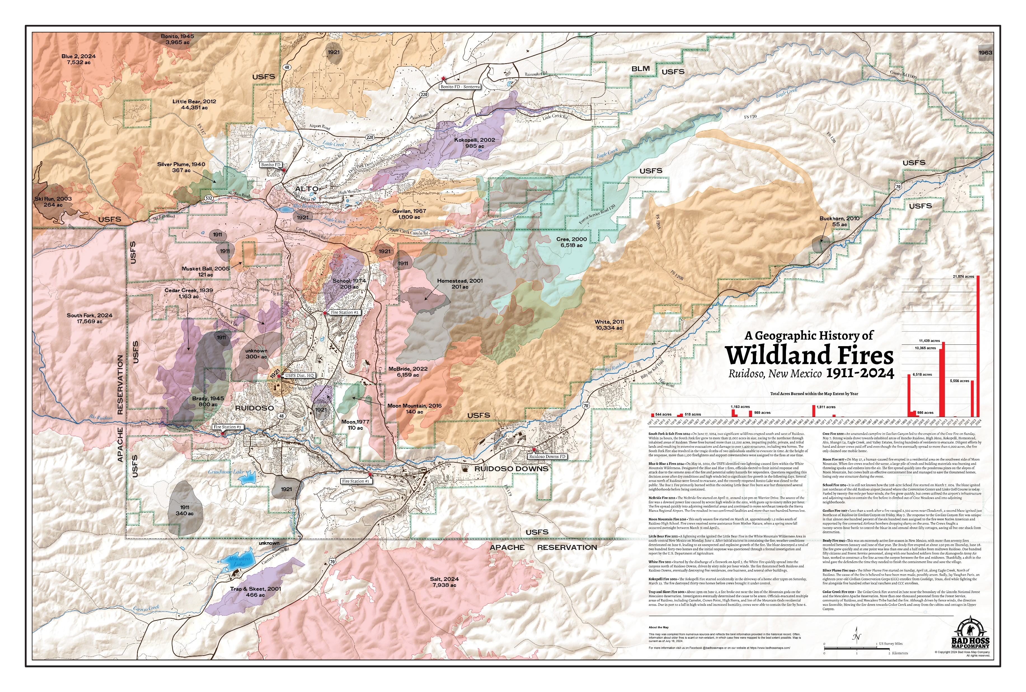

Slide 34
