Slide 1
Tri-State Wildfire Mitigation Program
WUFS Conference: October 9, 2024
John Hansen: Senior Manager of Asset Mangement and Field Services

Slide 2
Tri State G&T & the Wildfire Landscape

Slide 3
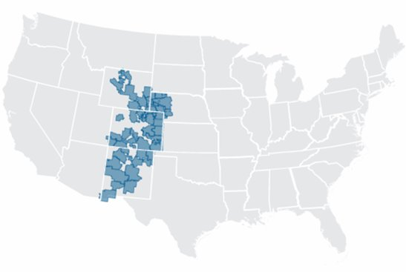
Tri-State Generation and Transmission, Inc
200,000 square mile service territory
​5,000+ miles of high voltage transmission lines serving our 42 distribution cooperatives
36,000 structures​
Balance safety, reliability and affordability

Slide 4
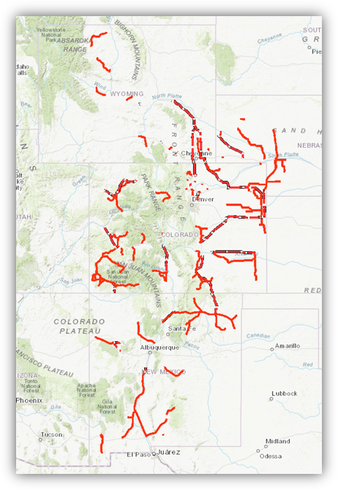
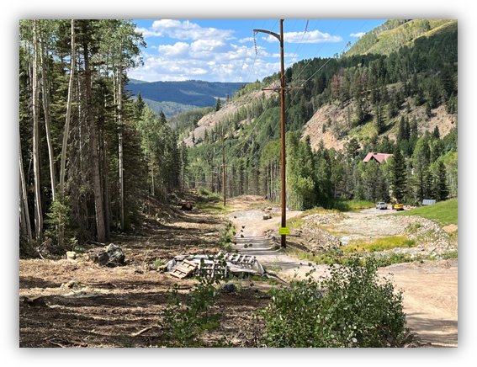
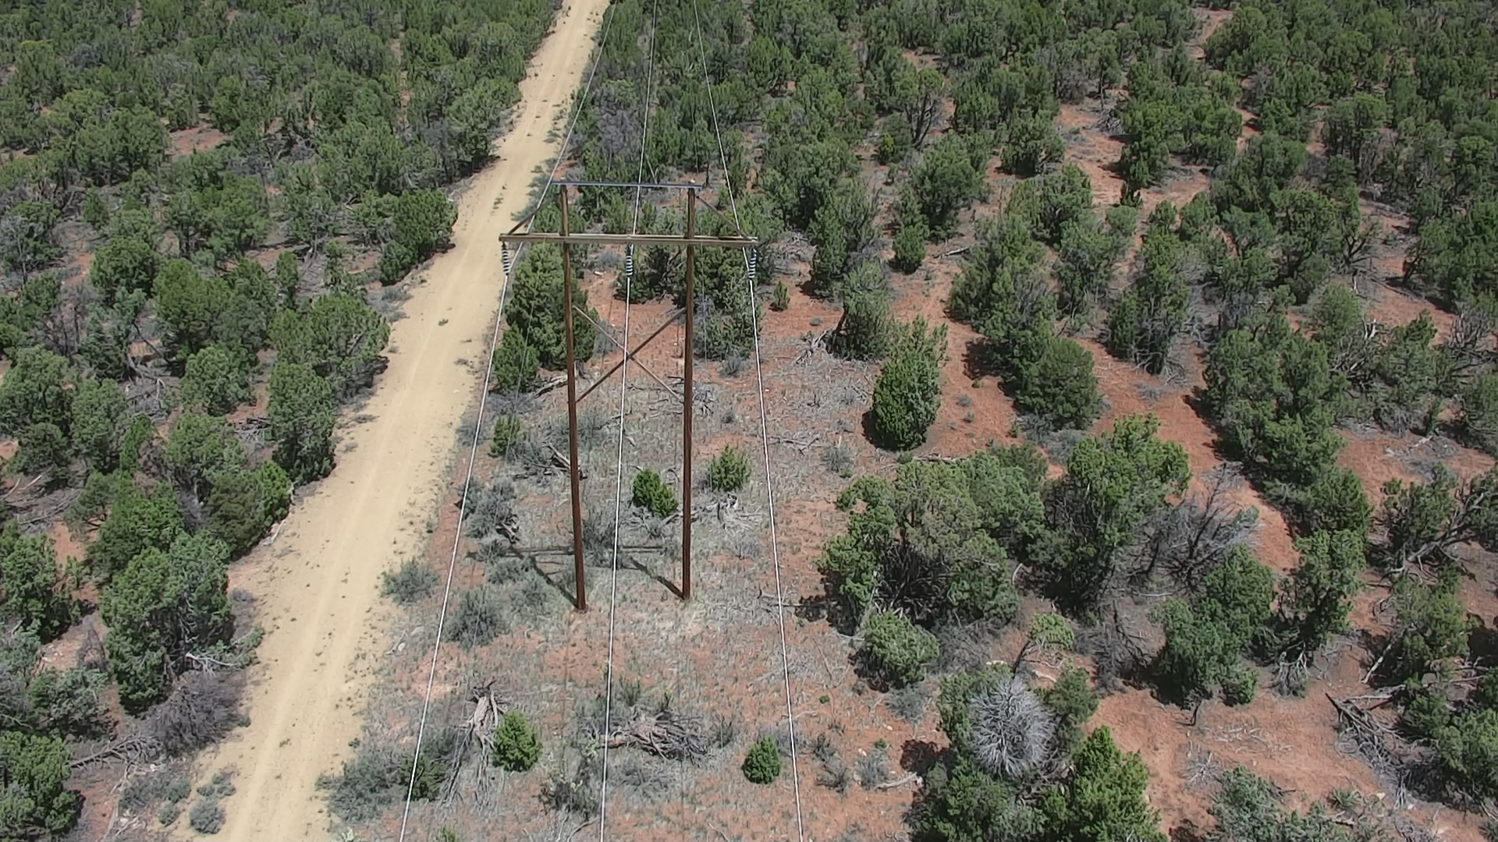
Wildfire Risks
Risk 1:Accidental Ignition from TS assets
Risk 2: Off ROW wildfire that compromises assets

Slide 5
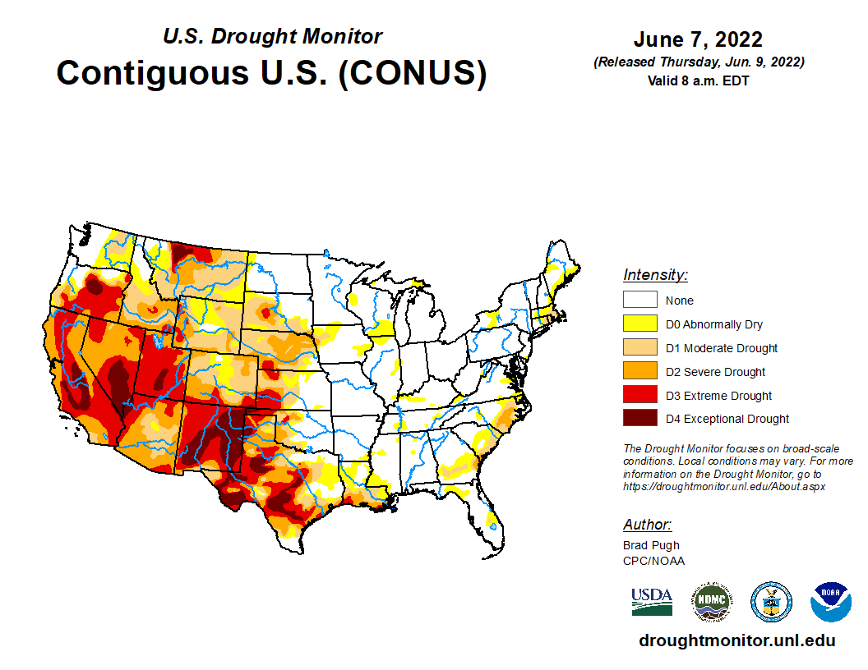
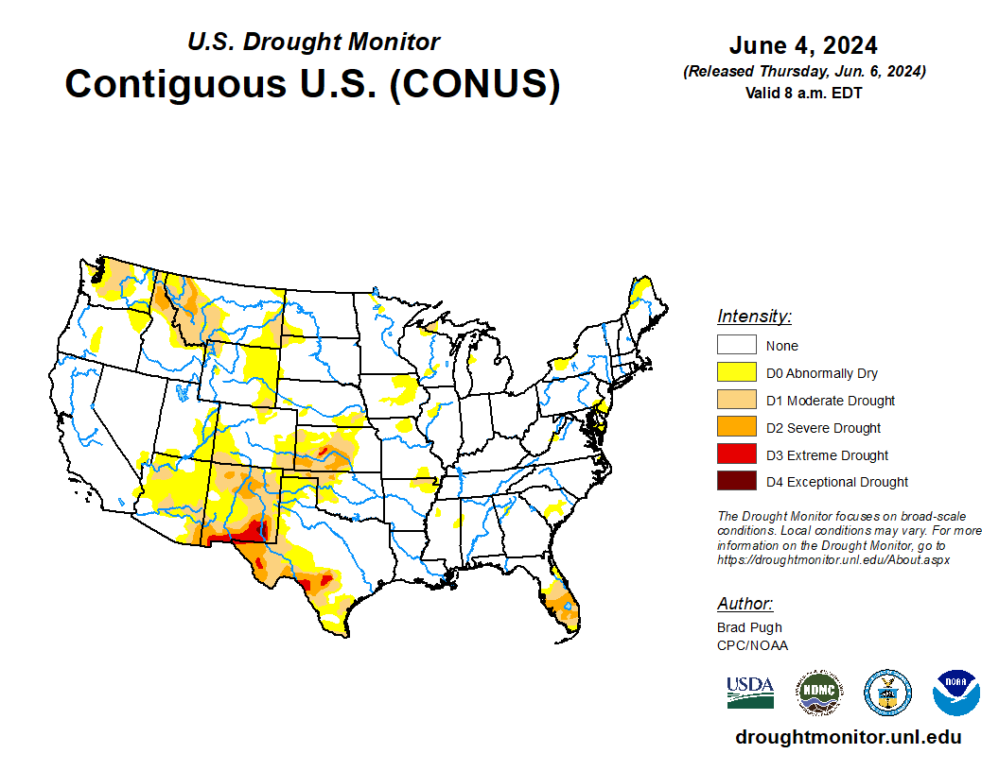
Wildfire Threat is Always Changing

Slide 6
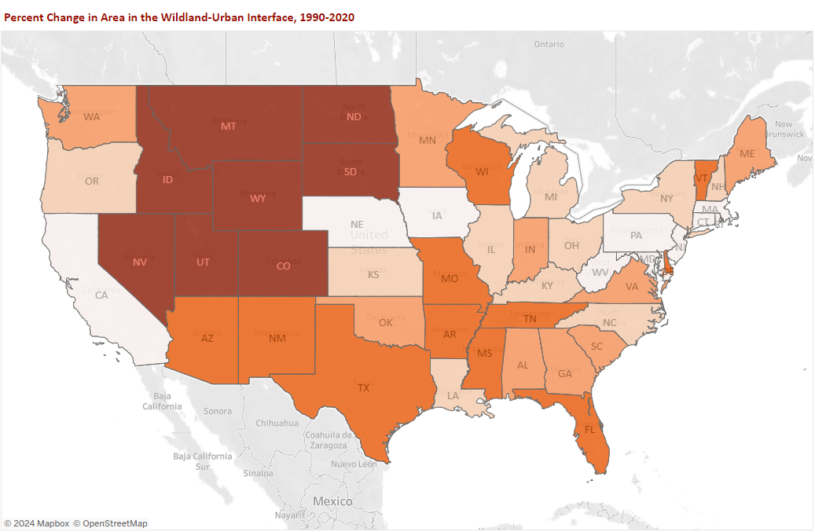

Wildland Urban Interface
US Forest Service Northern Research Station, 2023. Understanding the Wildland Urban Interface (1990-2020) (arcgis.com)

Slide 7
Risk Mitigation

Slide 8
Three Pillars
Fire Mitigation
Asset Management
Work & Asset Services

Slide 9
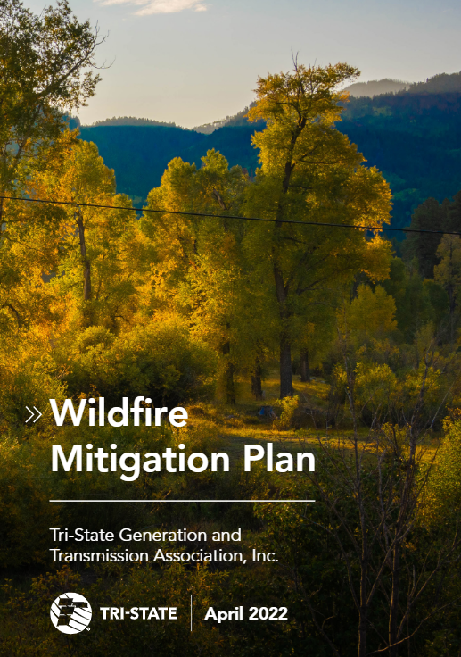
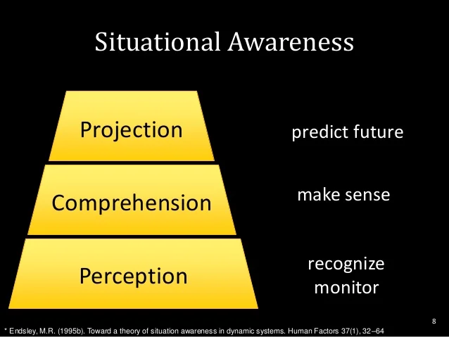
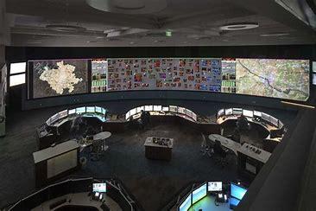
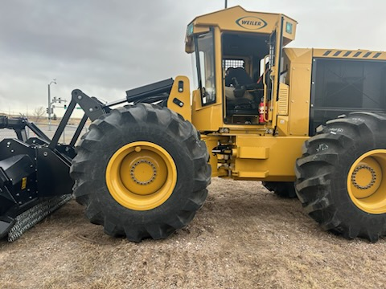
Wildfire Mitigation Plan

Slide 10
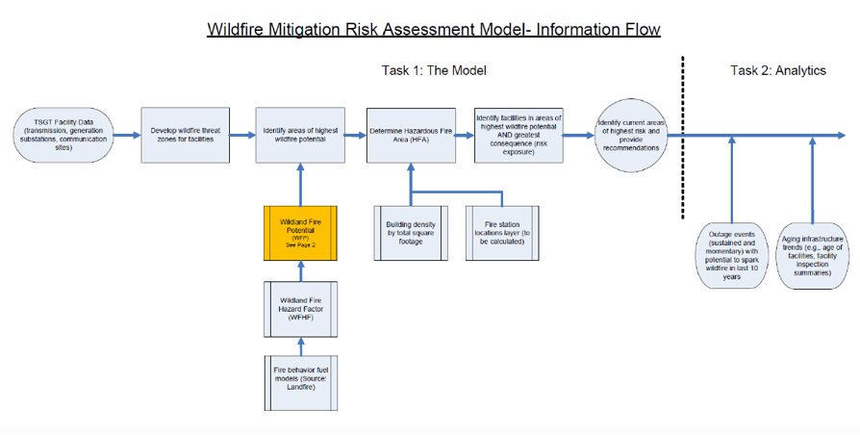
Situational Awareness ​
Assessment1: Studied the likelihood of TSGT asset being the ignition source of a catastrophic wildfire​
Assessment 2: Study the survivability of TSGT assets in the event of a catastrophic fire.

Slide 11
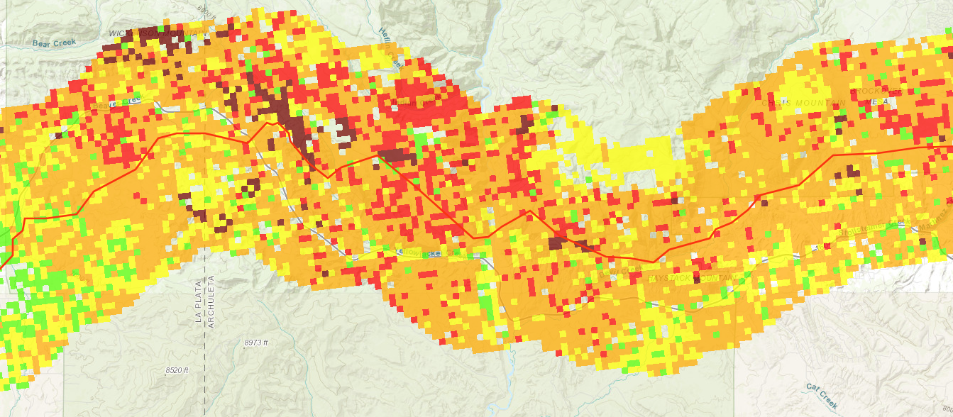
Situational Awareness
10% (600+miles )of Lines “Very High and “High” fire ignition risk
Prioritization and Implementation

Slide 12
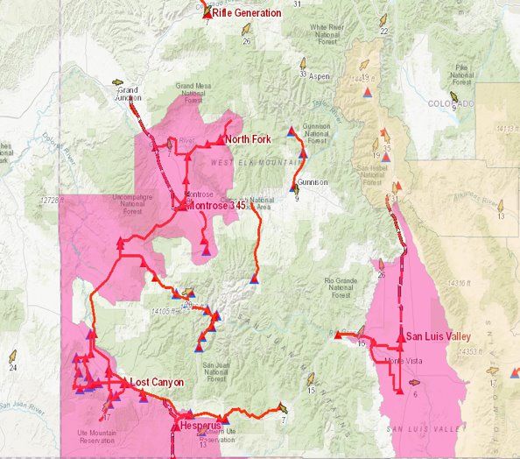
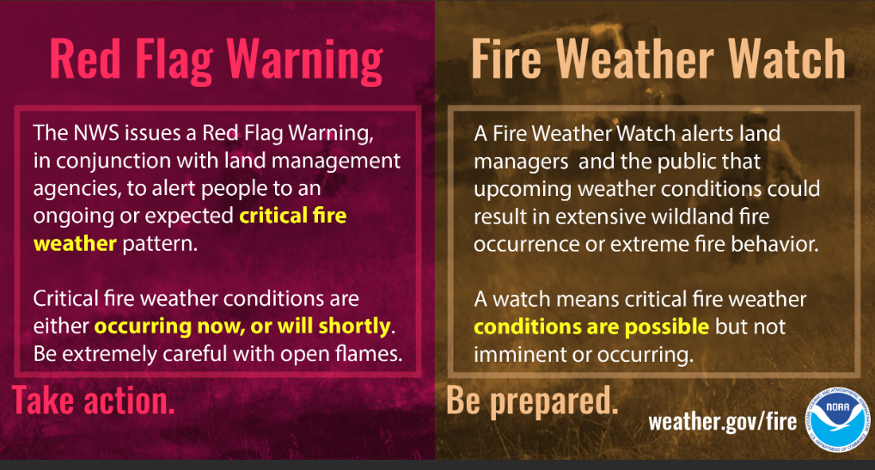
Situational Awareness
  365 Daily Situational Awareness Monitoring
    No Fire Weather
    Fire Weather Watch- 48 hrs
    Red Flag- Imminent
  Risk and Hazard Ranking
  Field Personnel Observations
  Standing Operating Orders
  Notification to field crews​ - 10 areas
  Limited or no use: drones, grinding, welding, blasting, etc.
  Lookouts, fire suppression, Fire Service

Slide 13
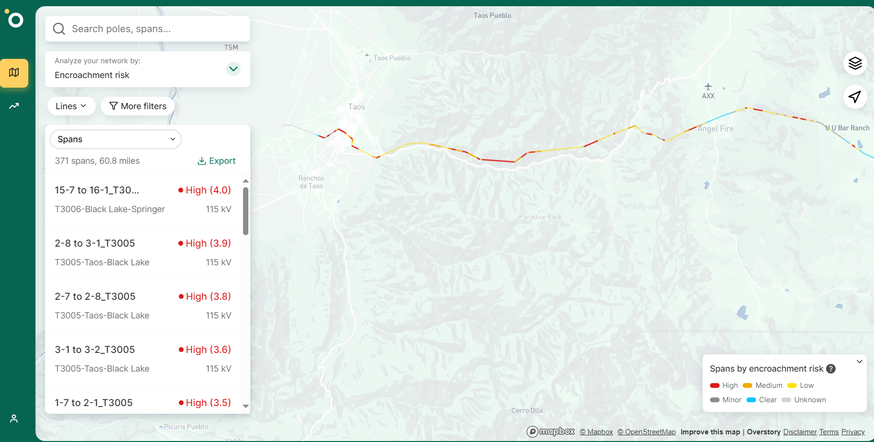
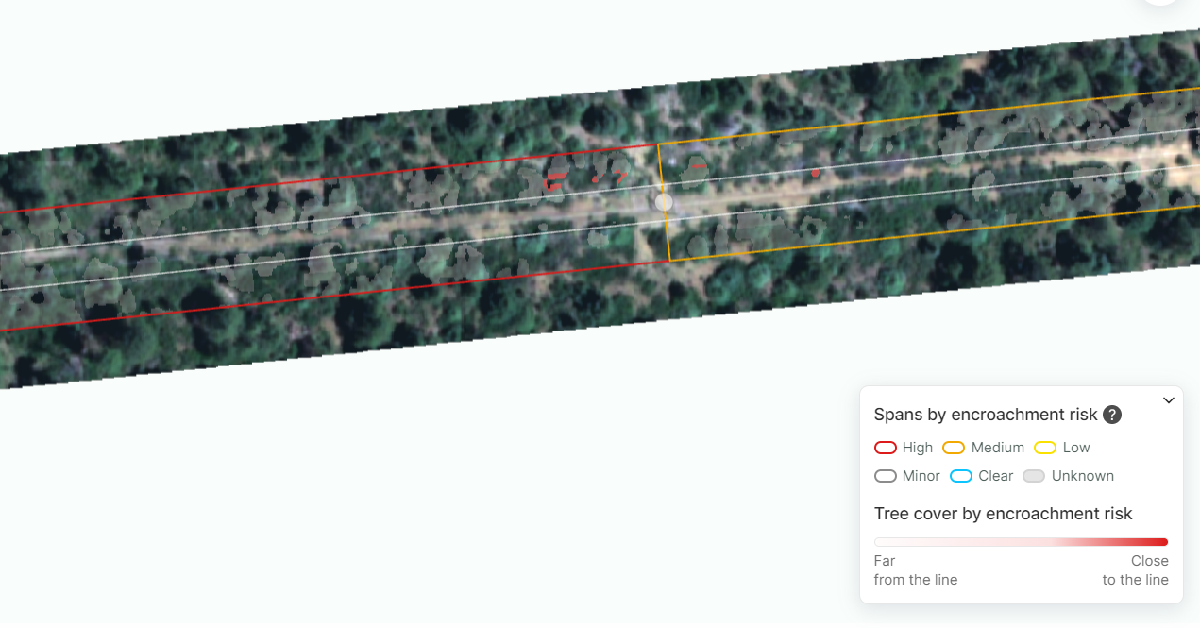
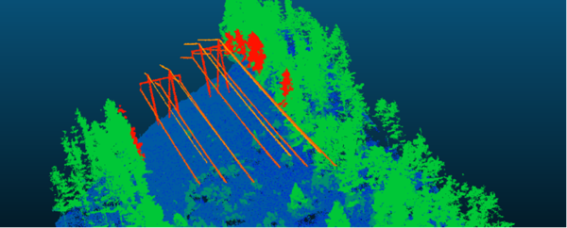
Intelligent Vegetation Management Systems
Satellite Data Collection
Strike/Danger Tree
Drone LiDAR Data Collection
Satellite outputs + Enhanced Asset Management benefits
Vegetation Growth Rates
Integration into SOW development and execution
Tree Health

Slide 14
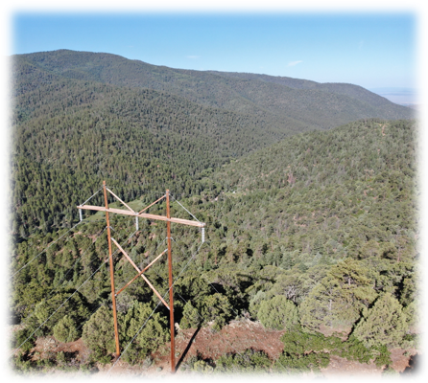
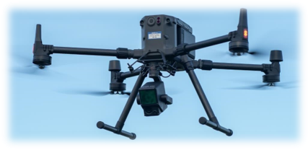
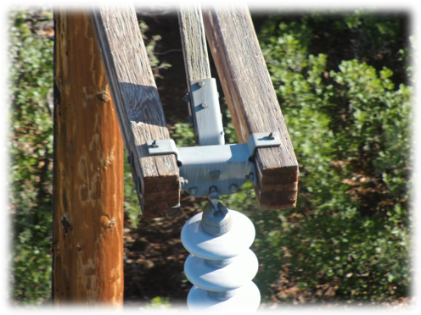
UAS (Drone) Program
Enhanced transmission line and substation inspection program
Multi benefit

Slide 15
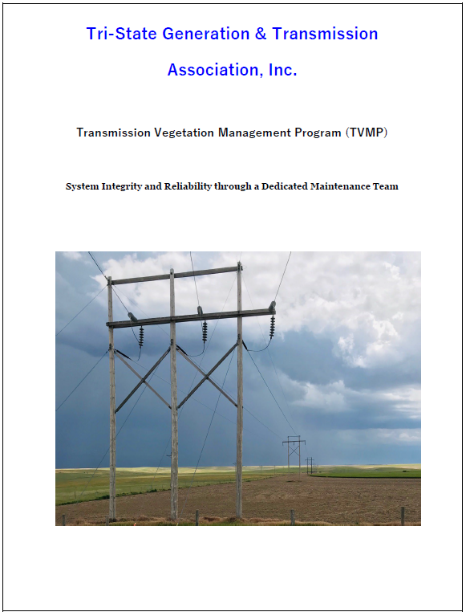
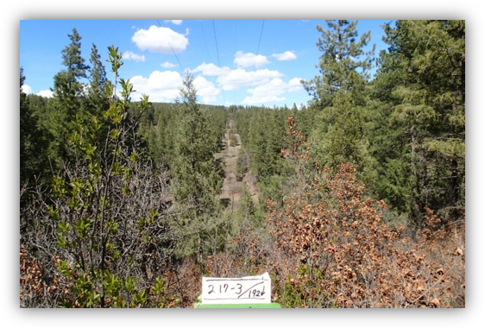
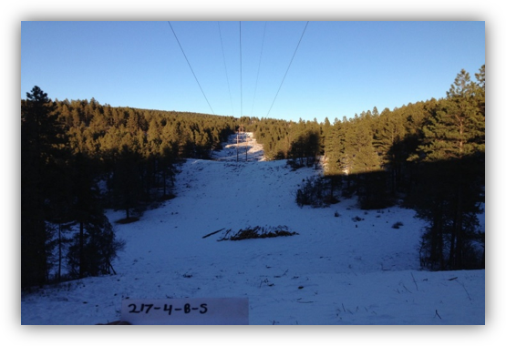
Transmission Vegetation Management Program
​Regulatory mandated, thoughtfully executed

Slide 16
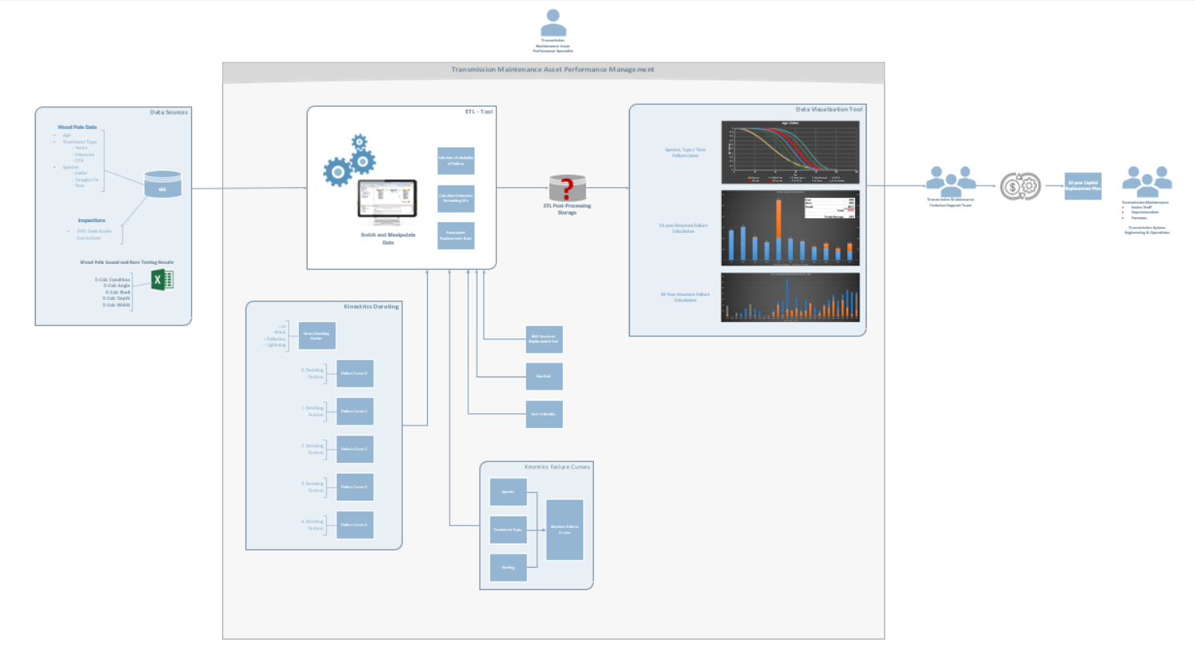
Asset Management and System Hardening
Data Analytics - Processing
Data Visualization & Enhanced Decision Making
Data Sources

Slide 17

Partnerships
Collaboration
Annual Colorado Utilities Wildfire Summit​
State Forest Service
USFS and BLM​
Local wildfire mitigation groups
Grants
CO Office of Energy/CO State Forest Service/ USFS
US DOE

Slide 18
Opportunities for Risk Reduction
Clean Energy Targets
50% clean energy by 2025
70% clean energy use by 2030
89% decarbonized from 2005 in Colorado
Federal and State Wildfire Legislation
Wildfire Mitigation Plan requirements
Potential for increased regulation
Liability protection
Advanced Situational Awareness
Enhanced arc and fault sensing
Cameras and meteorological stations
Remote Sensing
Can we understand more?
Can we build differently?
Can we plan together?

Slide 19
Questions & Conversation
John Hansen
Senior Manager Of Asset Management and Field Services
john.hansen@tristategt.org
Office: 303-254-3225
Mobile: 720-672-7800

